Slide 1
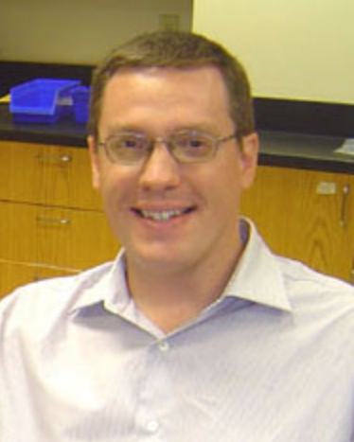
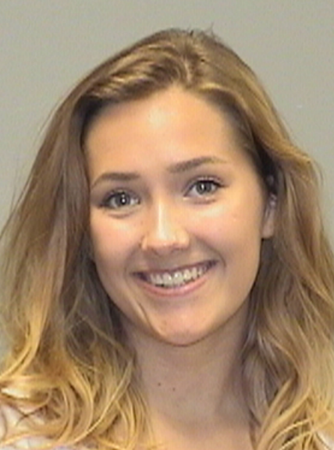
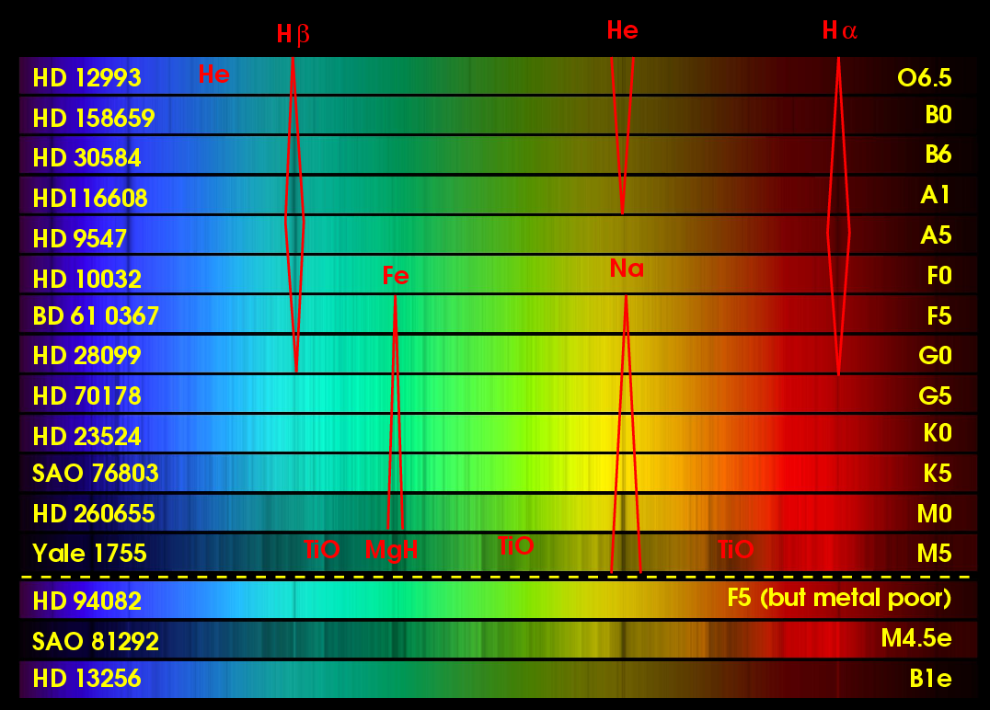
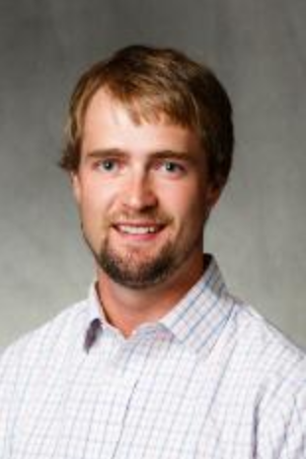
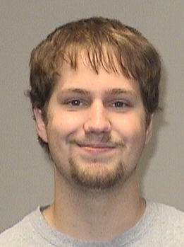
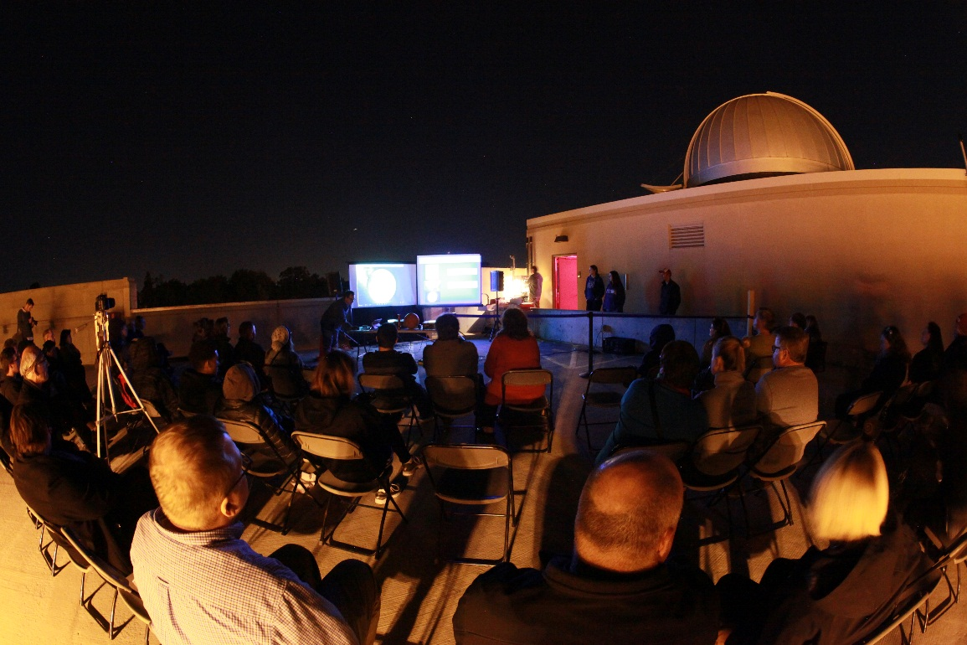
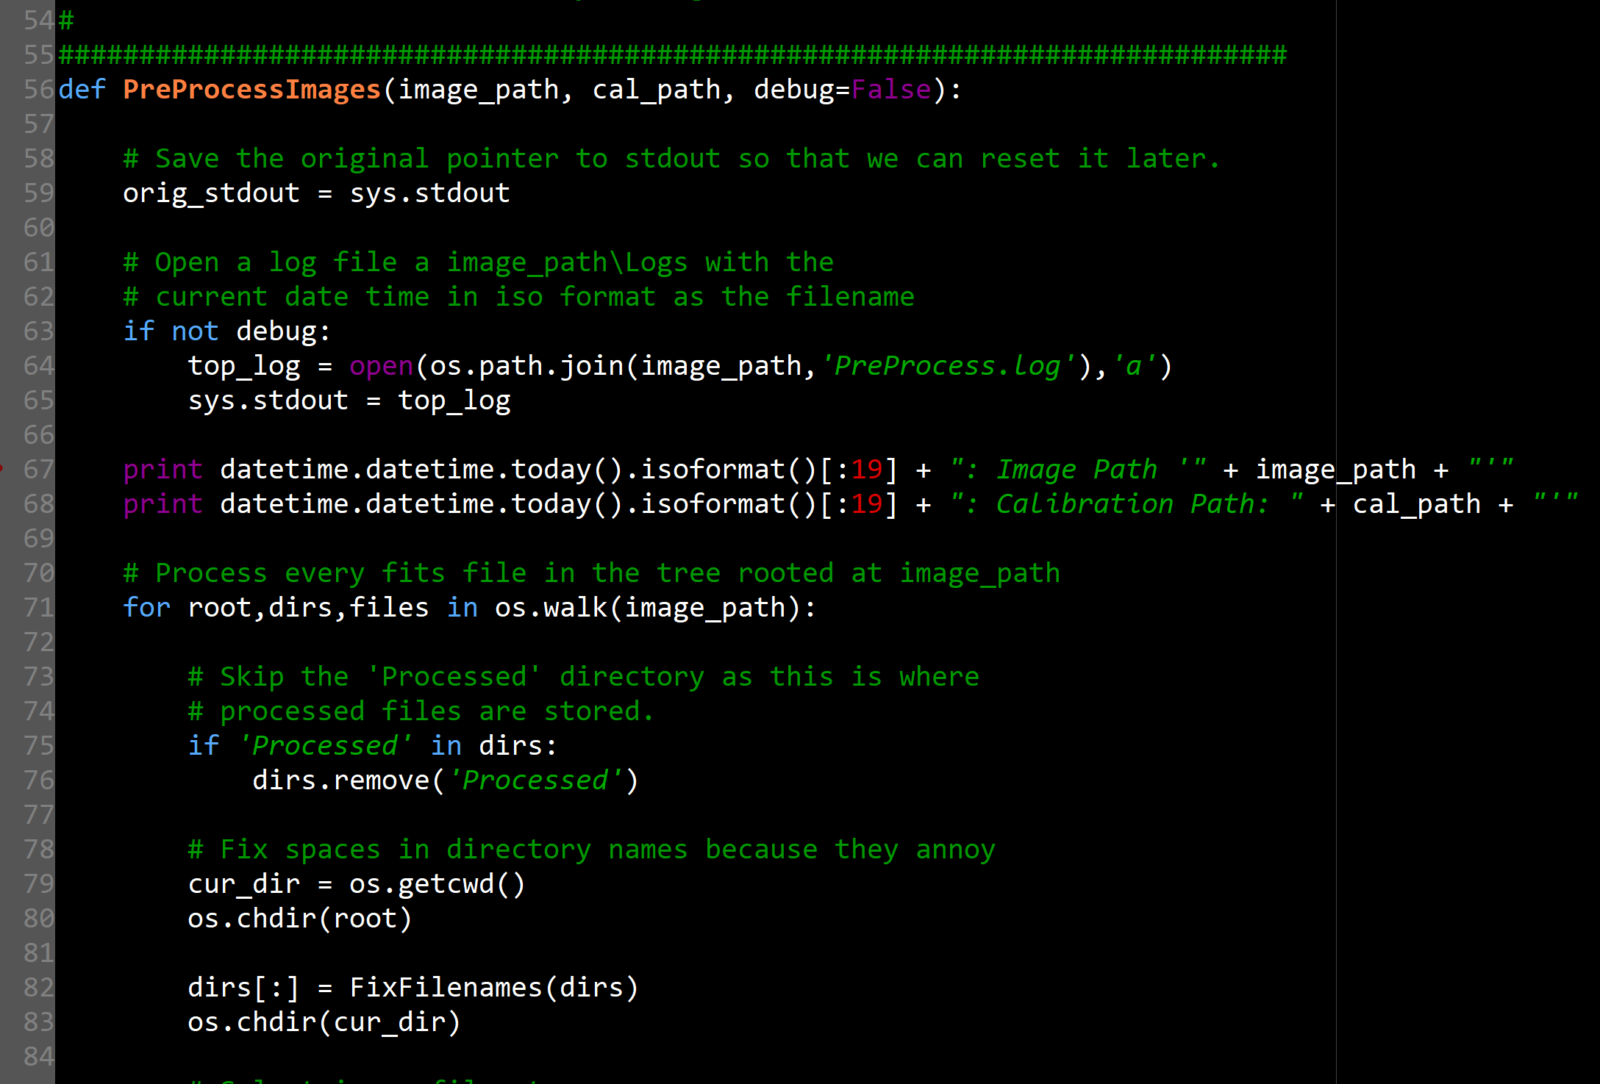
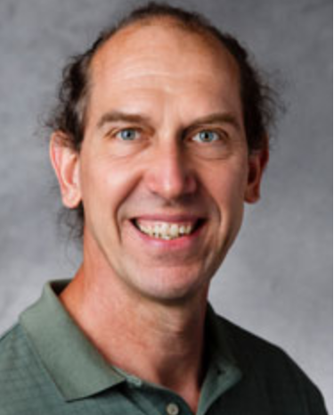
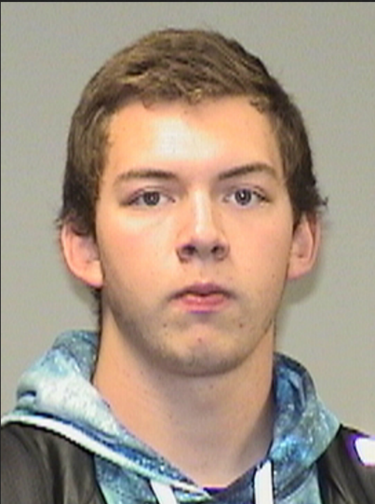
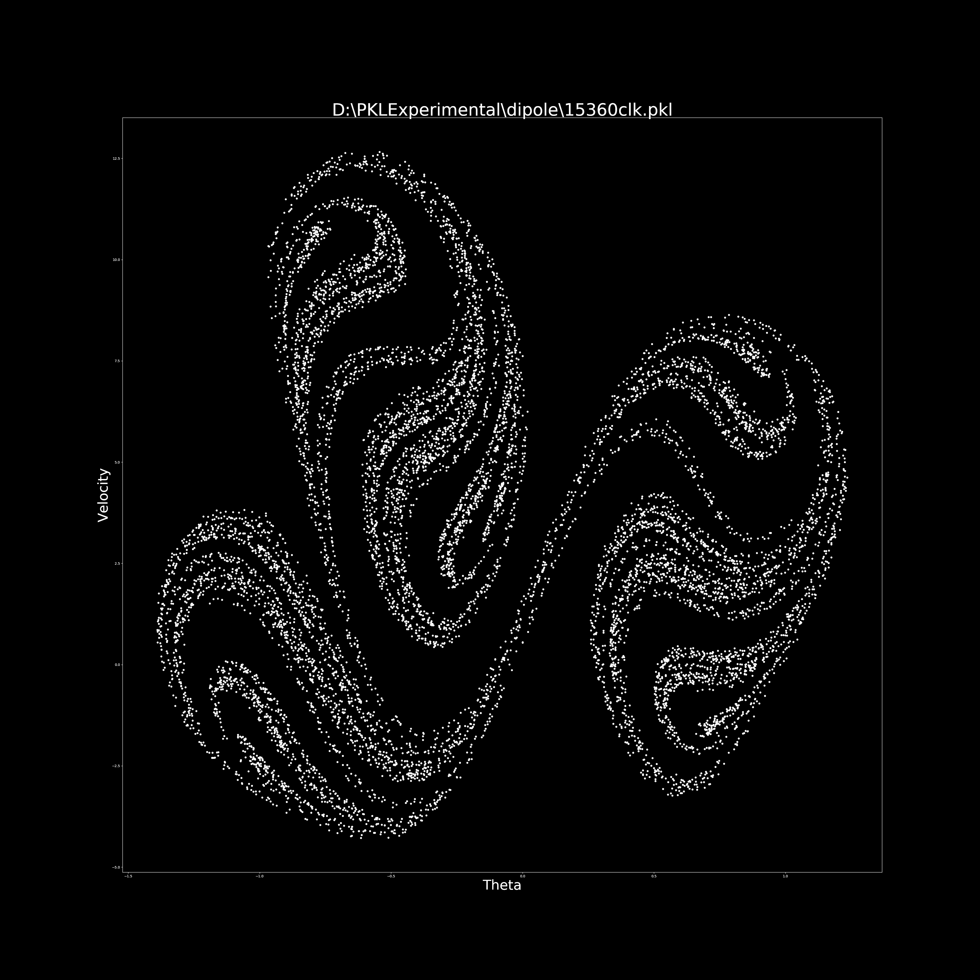
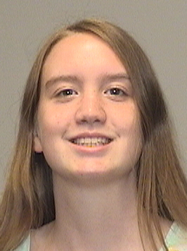
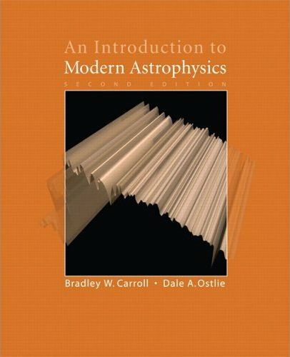
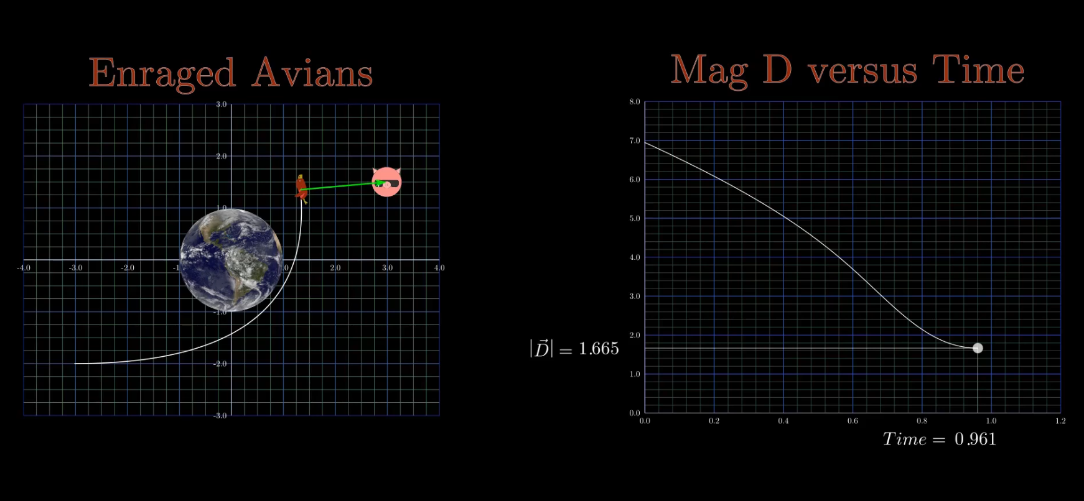
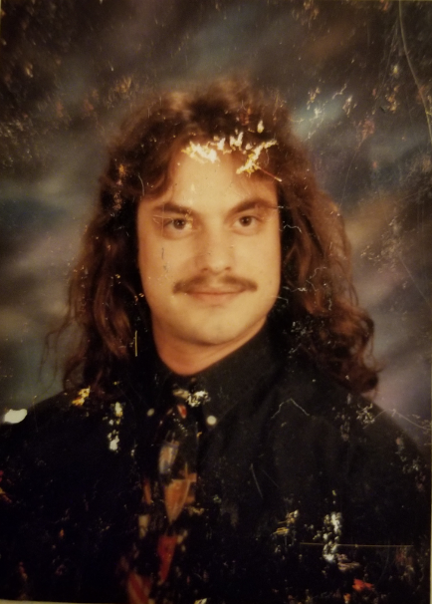
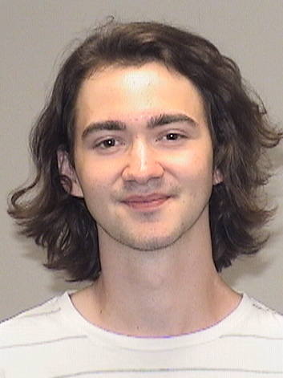
University of St. Thomas MnSGC Activity
Outreach/Informal Ed.
Research
Faculty
Mike Wood
Marty Johston
Stellar Spectroscopy
Measure atomic spectra in the lab
Identify stellar abundances
Faculty/Staff
Rich Schuler
Adam Green
Student workers
Anneila Anderson
Michael Peters
Chaos
Computationally testing chaos quantification techniques.
Creating computational models of chaotic systems.
12 outreach events per year
Events held at the UST Observatory
10 small events with ~20 attendees
2 large events with ~100 attendees
Student workers
Natalie Meyers
Colton Stoner
Higher Ed.
Faculty
Mike Wood
Gerry Ruch
Course Development
Upper level Astrophysics
Ties into the observatory
Student workers
Natalie Meyers
Mike Twohy
Educational Video
Software library render animations
High quality video content distributed through YouTube

