Slide 1
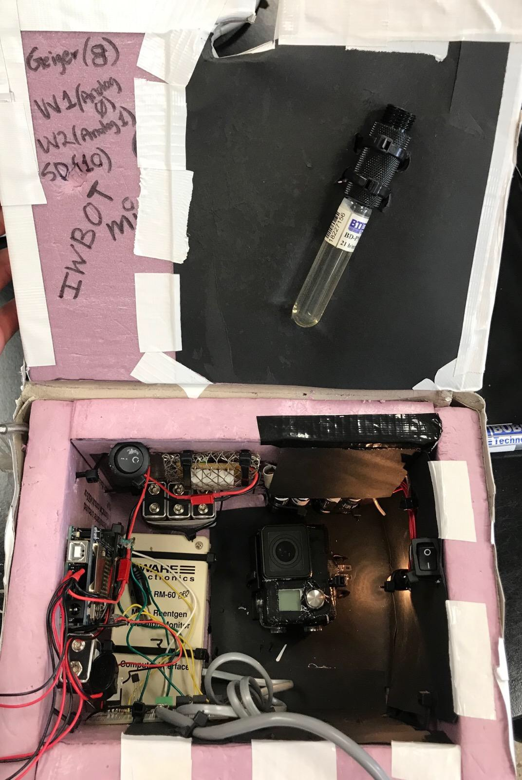
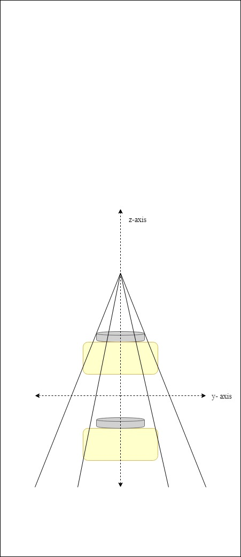
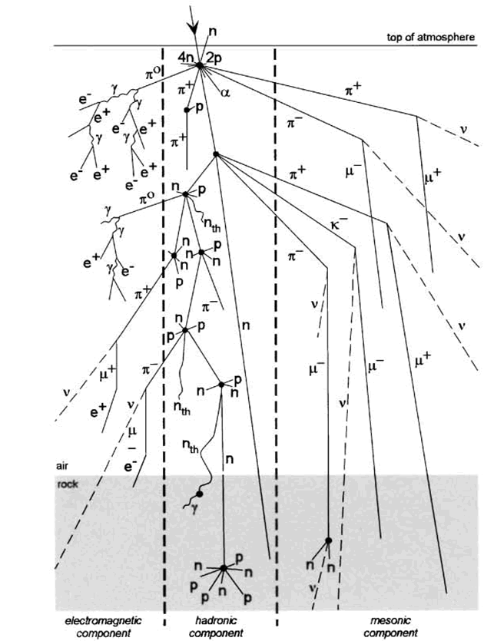
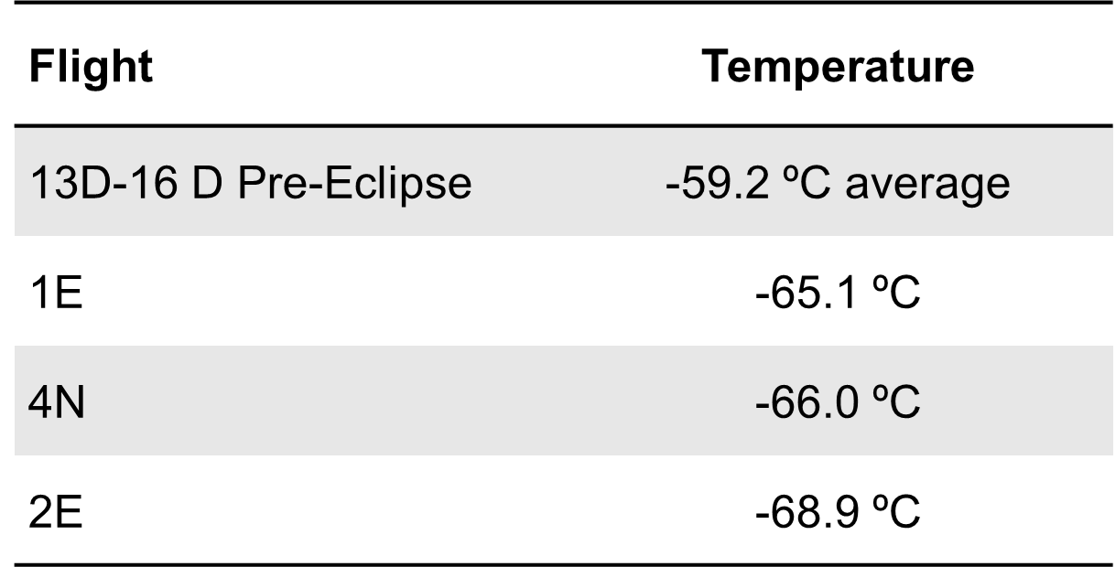
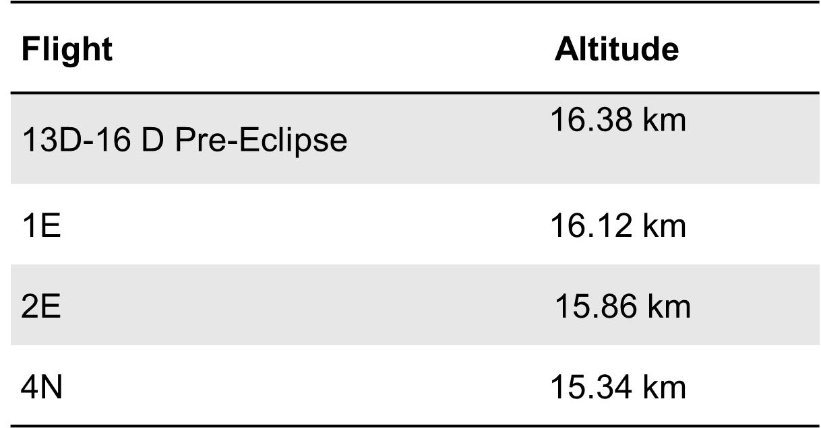
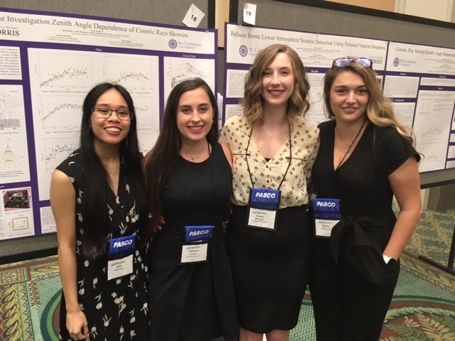
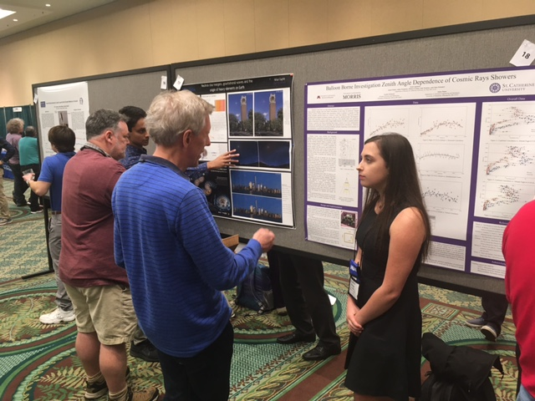
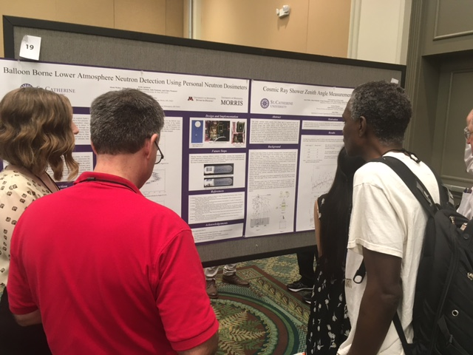
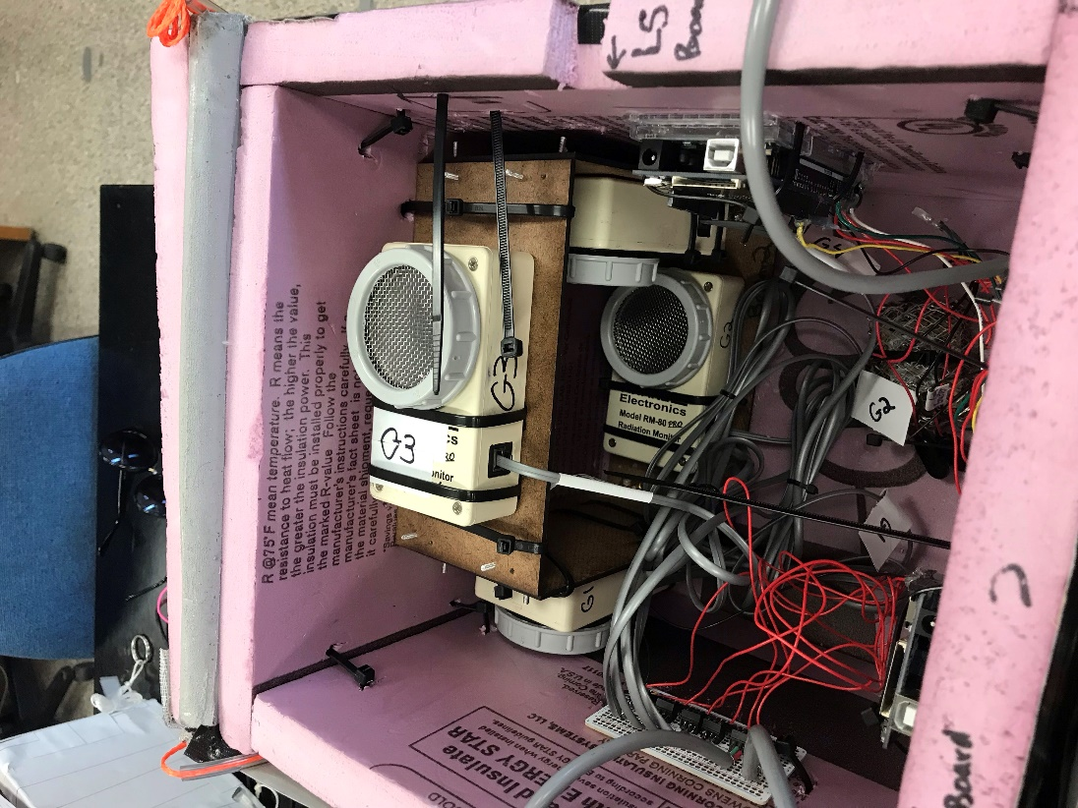
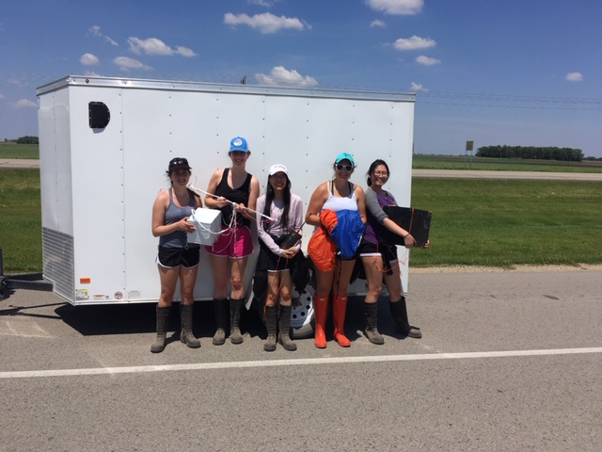
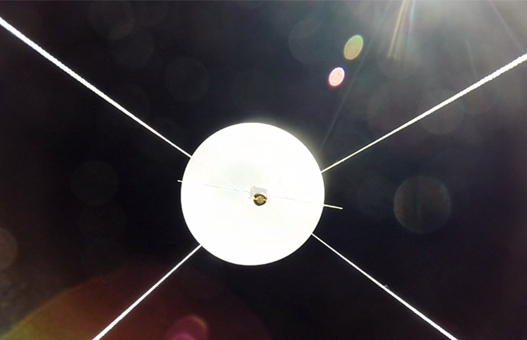
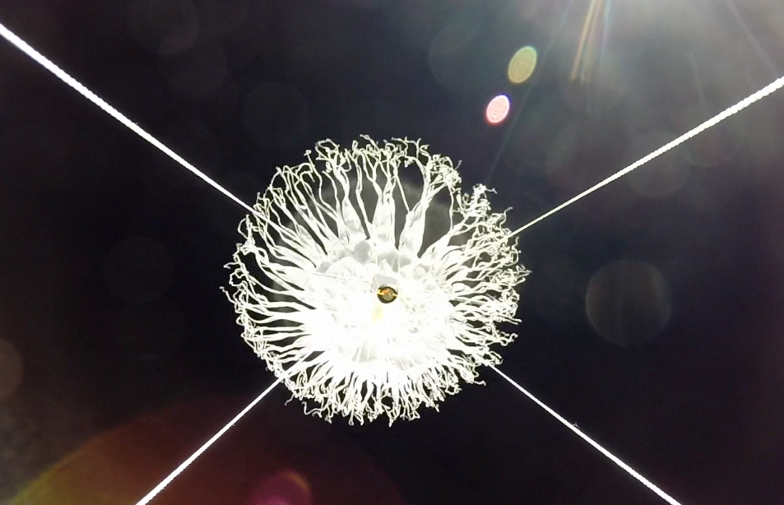
NASA’s MN Space Grant Consortium (MnSGC) Activities at St. Catherine University
Fellowships/Scholarships
All scholarships given to women perusing work in a STEM field: Awardees from 2019 are:
Alisha Wiedemeier, Alyssa Wicks, Calli Clay, Maya Butler, Judy Panmany, Ella Graham, Megan Moberg.
.
Faculty
Erick Agrimson – stratospheric ballooning research and informal education
Hannah Kinney – cosmology research and higher education
NASA-Related Research
Support both faculty and students in research.
Research team for 2019 -2020
Alisha Wiedmeier – Class of 2020 spring
Judy Panmany – Class of 2020 fall
Melissa Graham – Class of 2020 spring
Claire Weinzierl – Class of 2020 spring
2021 High Altitude Ballooning Team:
Anisa Tapper – class of 2023
Callie Koreniowski – class of 2023
Jillian Durand – class of 2023
Presentations for 2019 and 2020
Keynote address: IA AAPT Ames IA Oct 25 2019.
AAPT Winter Meeting January 18-22 2020
Outstanding poster award in SPS:
group 4 of 22 posters chosen
Scholars at the MN Capitol March 11 2020
Informal Education
Support of work with 4-H programs around the state of Minnesota with emphasis on Rocketry and High Altitude Ballooning activities.
New Society of Physics Students chapter formed
Higher Ed Course Development
Support new-course development and the
revision of existing courses on topics of
particular interest to NASA, such as rocketry, astronomy and high altitude ballooning.
Matching Requirement
All recipients of MnSGC programmatic
(i.e. non-Fellowship/Scholarship) funds
are required to provide at least a 1-to-1
match of new-money or in-kind value.
Learn More / Contact Us
St. Catherine University MnSGC Affiliate Director:
Prof. Erick Agrimson epagrimson@stkate.edu
General MnSGC e-mail: mnsgc@umn.edu
General MnSGC website: http://www.mnspacegrant.org

