Slide 1
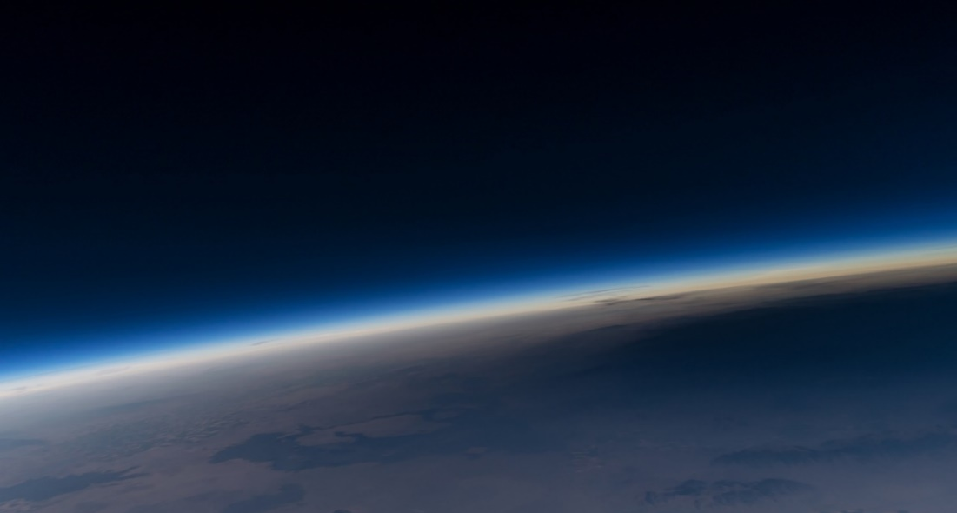
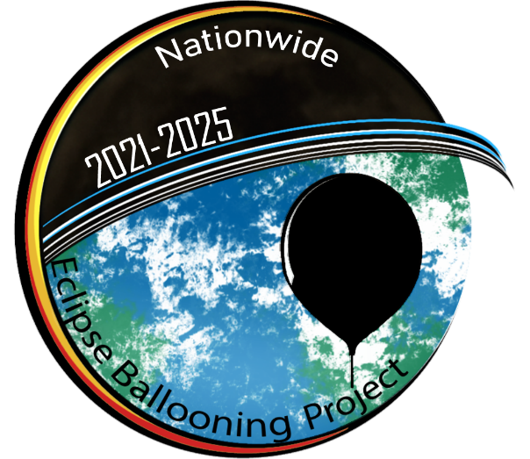
“Possibilities for STEM engagement in the Nationwide Eclipse Ballooning Project 2021-2025”
Randal M. Larimer, PE
Deputy Director Montana Space Grant Consortium

Slide 2
Abstract
Montana Space Grant Consortium along with teams from the University of Kentucky, Idaho Space Grant Consortium, University of Maine, Minnesota Space Grant Consortium, Louisiana Space Grant Consortium, Oklahoma State University, Plymouth State University and the University of Bridgeport along with experts from the University at Albany, SUNY and the Universities Space Research Association/NASA Goddard Space Flight Center are proposing a multi-year ballooning project called the “Nationwide Eclipse Ballooning Project 2021-2025.”
Our underlying goal is to broadening participation of STEM learners by immersing teams in a mission like ballooning opportunity that engages participants with subject matter experts in scientific designing, building, testing, flying, analyzing and publishing of results. There are two tracks to this ballooning opportunity consisting of 30 teams in the atmospheric science track and 40 teams in the engineering track. An overview of the possible opportunities is presented.

Slide 3
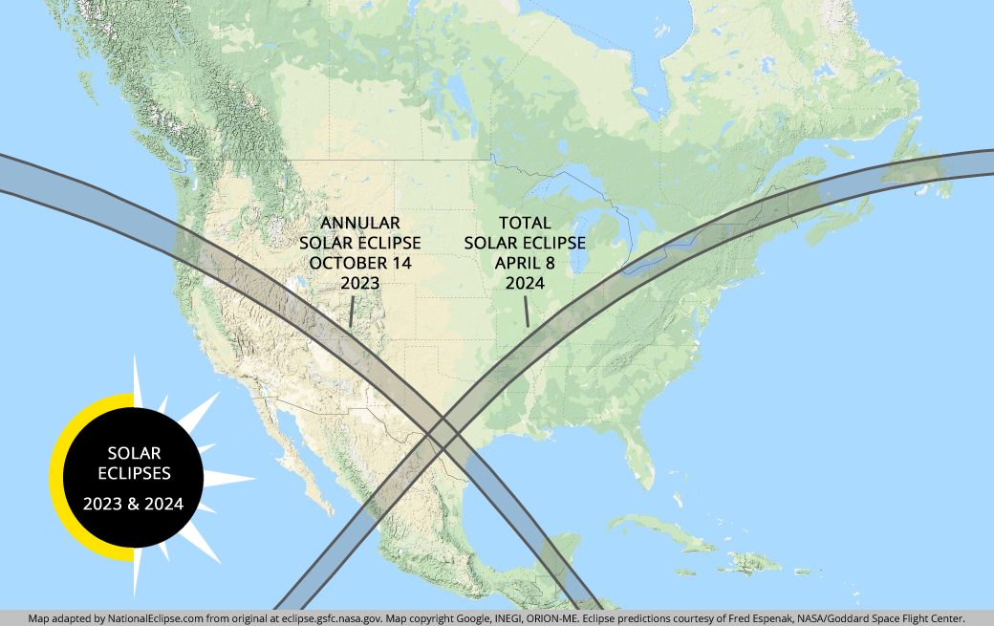
Conduct Scientific Ballooning Experiments During 2023 and 2024 Solar Eclipses

Slide 4
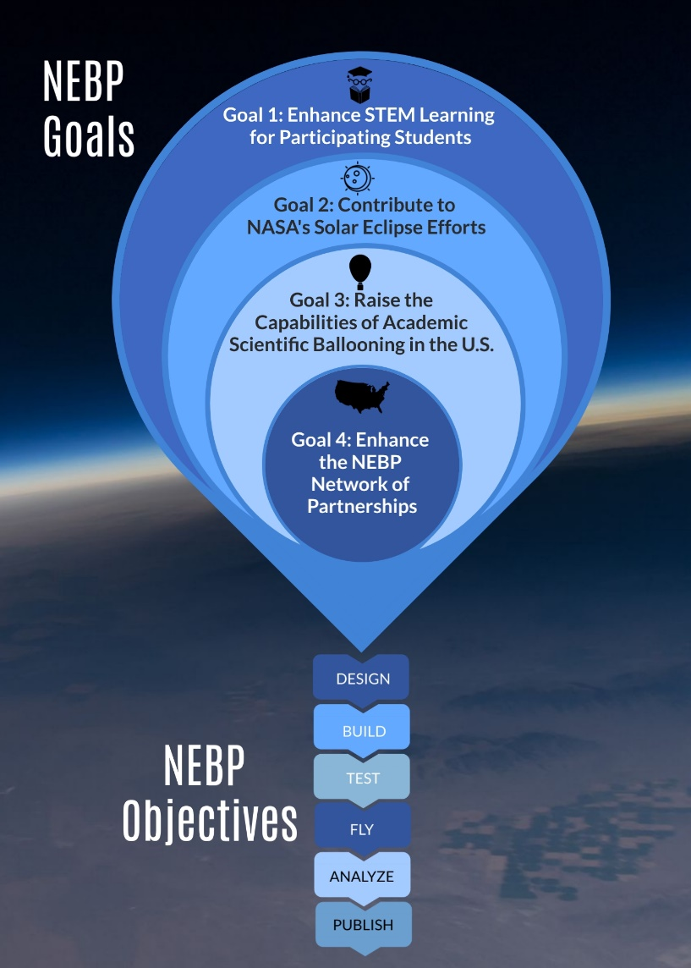

Slide 5
Radiosondes and Engineering Balloon Platforms
For the purposes of this project, we generalize two types of scientific ballooning tools typically used in academia; radiosondes and balloons carrying payloads engineered by students, or “engineering balloon platforms”.
Radiosondes are small, with payloads of less than 190 grams of balloon-borne instruments that are used to measure atmospheric parameters through the stratosphere.
Engineering balloon platforms are capable of lifting up to 12 pounds of payload into the stratosphere. Typical experiments include atmospheric measurements, photography, GPS tracking systems, cosmic radiation measurements, and space technology proofs of concept.

Slide 6
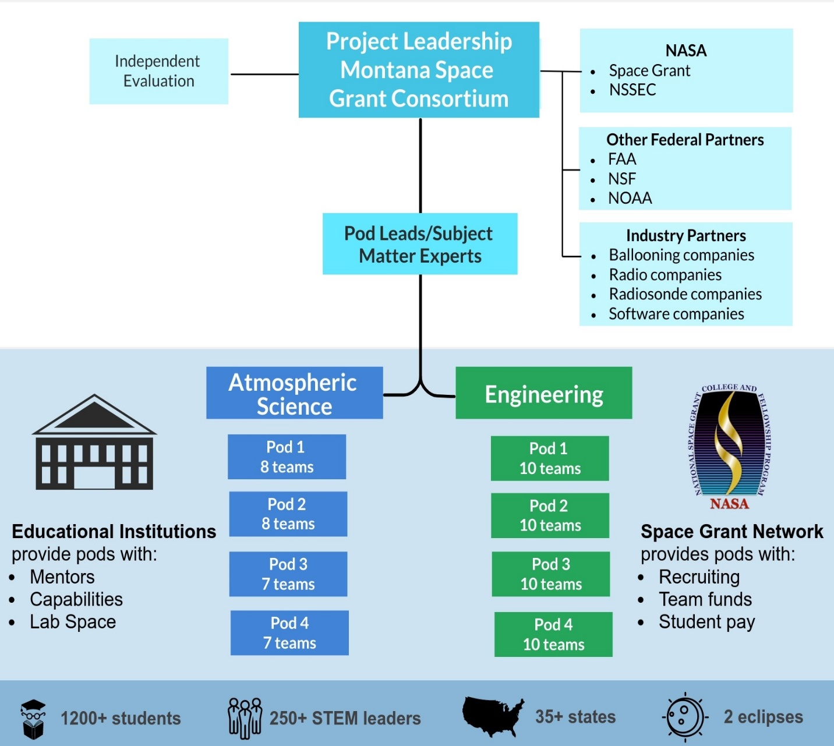
Project Structure and Team Member Roles
The leadership team is headed by the Montana Space Grant Consortium (MSGC) and includes a NASA scientist, an atmospheric science expert, and ballooning experts who will serve as leads for each of the eight pods. The leadership team will oversee planning, payload system refinements, team training, and collaboration management.
70 teams, 30 for atmospheric science and 40 for engineering. Each team is comprised of 6-30 students and 1-6 mentors.
Teams will be divided into eight pods, four for each atmospheric science and engineering. These pods will represent four different regions within the US, divided into quarters. The pod structure will facilitate effective communication and training.
Every team will receive ballooning supplies and engineering system materials or radiosondes.

Slide 7
Team Members
MSGC leadership team consisting of the PI, Angela Des Jardins, who led the 2017 eclipse ballooning project; the atmospheric science lead, Jennifer Fowler, who led the 2017, 2019, and 2020 atmospheric science campaigns; the engineering lead, Randal Larimer, who led the development of the 2017 common payload and tracking system; and our two MSGC ballooning flight directors, Carl Spangrude and a new hire.
Two atmospheric scientists, Junhong Wang from the University at Albany SUNY; and Jie Gong from NASA’s Goddard Space Flight Center.
Atmospheric Science pod leads are Sean Bailey from the University of Kentucky; Matthew Bernards from the Idaho Space Grant Consortium; Jamey Jacob from Oklahoma State University (OSU); and Eric Kelsey from Plymouth State University.
Engineering pod leads are Richard Eason from the University of Maine; James Flaten from the Minnesota Space Grant Consortium; Doug Granger from the Louisiana Space Grant Consortium; and Jani Pallis from the University of Bridgeport.

Slide 8
Atmospheric Science and Engineering Methodology
Student teams participating in the atmospheric science project will use ground-based instruments and balloon-borne payloads to examine how a solar eclipse affects atmospheric characteristics through the stratosphere.
In addition, the engineering teams will live stream high-quality video from the stratosphere during the eclipses. Sensor data will be collected throughout the flights.
The methodology described below builds upon our successful, extensive work from the 2017, 2019, and 2020 eclipses and was developed in consultation with subject matter experts.

Slide 9
Core Atmospheric Scientific and Engineering Questions
• Can eclipse-induced atmospheric gravity waves be definitively detected in data across all sites?
• What is the magnitude of the temperature drop at the surface, in the planetary boundary layer (PBL), troposphere, and stratosphere?
• How much time lag is there between the temperature minimum and minimum in solar flux?
• At which altitude(s) is the temperature variation the largest?
• How do boundary layer heights vary during an eclipse?
• Is the kinematic response of the surface wind field within the path of totality instantaneous or timelagged to the thermal response?
• How do the findings for the 2023 and 2024 eclipses compare to those for prior events?
• Can current high-resolution weather-forecasting models simulate the observed responses and improve the model physics and forecasting?
• Can a lower-cost gravity wave imaging payload be developed?
• How far can reliable streaming video be transmitted?
• Can a lower-cost, common payload with sophisticated capabilities be developed?

Slide 10
Atmospheric Science Radiosondes – Field Campaign
At sites along the path of totality, we will make frequent observations by launching hourly radiosondes on weather balloons to 100,000 - 110,000 feet.
In addition, we will collect high-temporal resolution surface-site data.
This design will provide surface, lower, and middle atmospheric observations with enough spatial and temporal sampling to contrast the meteorological differences before, during, and after the eclipse.
The surface stations will provide independent measurements of solar irradiance at the surface.

Slide 11
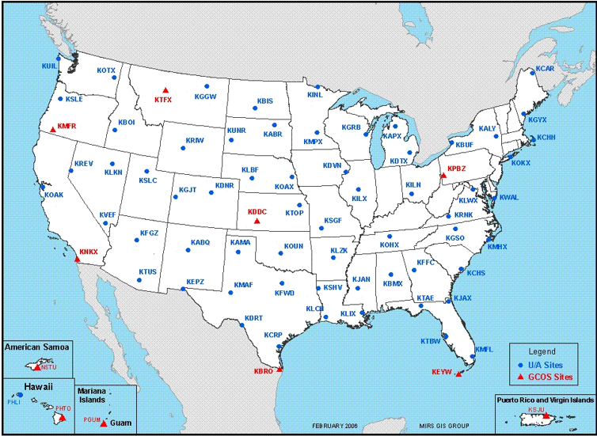
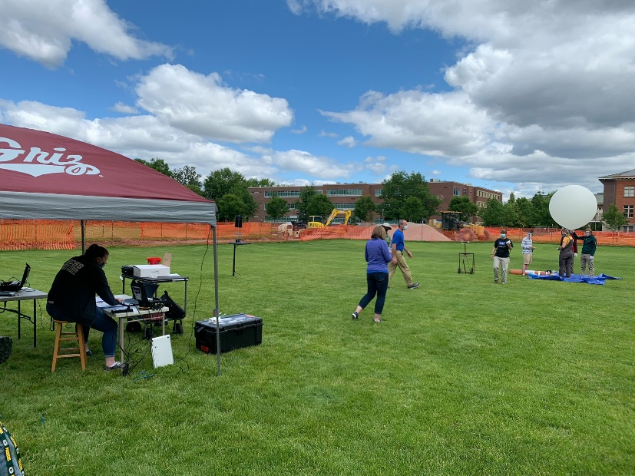
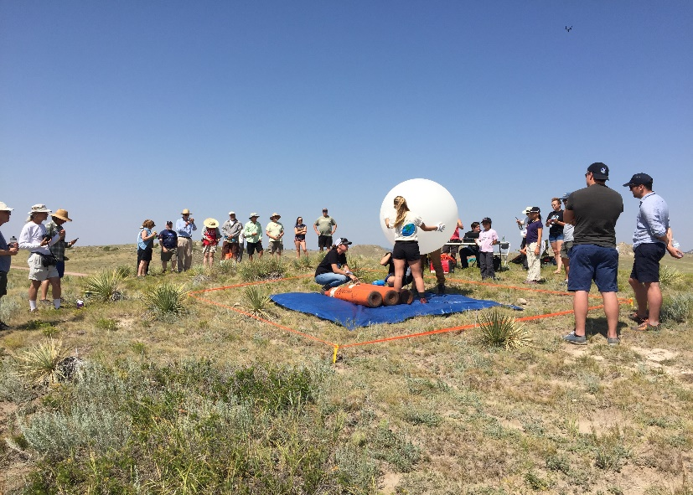
2020
2017

Slide 12
Engineering Balloons – Field Campaign
We will refine and develop innovative large balloon common systems to live stream high quality video to the NASA eclipse website from altitude, measure atmospheric parameters, track the path of the balloon, safely terminate a flight, and image eclipse induced atmospheric phenomena.
Expert engineers from several academic ballooning programs will be pod leads and with the project leaders, will form a core engineering team.
In addition, individual engineering teams will design, and fly their own science experiments.

Slide 13
Engineering Balloon System Details.
Each balloon payload string will have a proven ultra-low power Iridium tracker modem that will enable display of the near real-time balloon location on our flight tracker website, for use by the FAA and other stakeholders.
Each balloon flight will use the Iridium tracker modem to provide a reliable method to remotely command cutting the balloon away from the payload string.
The database associated with the tracking website is used to point ground-based antennas at the payloads during flight for direct data or video transmission.
The encoded video is formatted and sent to the NASA eclipse website over an internet connection for real-time viewing of the eclipse from that unique location. The video streaming and imaging payload is an area of rapid change in capability since the 2017 eclipse project and will be the focus of redesign for this project.
An area of new design is the specialized mid-wave infrared image sensor capable of showing visual evidence of eclipse-driven gravity waves.

Slide 14
2017 Eclipse Image from a High-Altitude Balloon

Slide 15
Atmospheric Science and Engineering Provide Materials
Science - small balloons with radiosondes
Ground Station, computer for running and power inverter (3 per team) $25,200
Lufft Surface Stations (1 per team) $5,762
Engineering – large balloons with common payloads
Ground Station, common payload and computer (1 per team) $10,700

Slide 16
Stay Tuned for Project Updates
Questions?
2017 Eclipse Workshop with Engaged Students and Mentors at Bozeman, Montana

