Slide 1
High Altitude Student Platform (HASP) 2021
T.G. Guzik, D. Granger Louisiana Space Grant Consortium Department of Physics & Astronomy Louisiana State University
Thanks to new NASA Science Mission Directorate (SMD) support for 5 years!

Slide 2
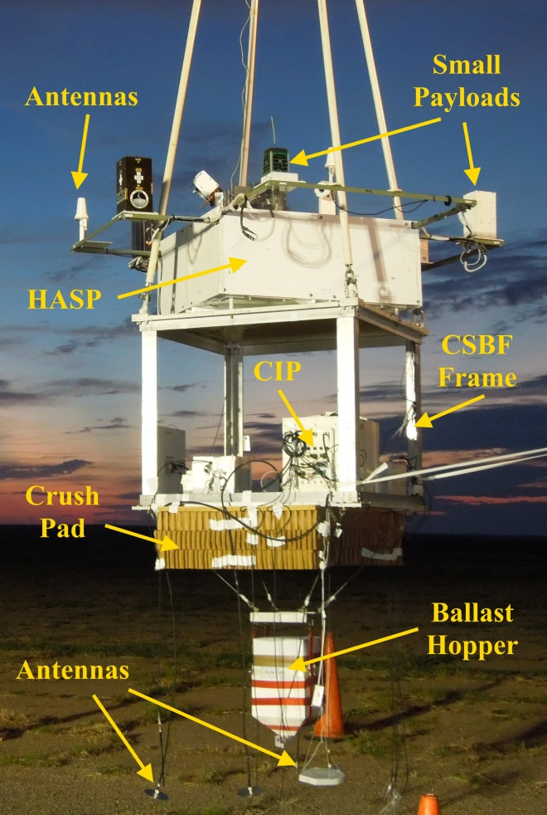
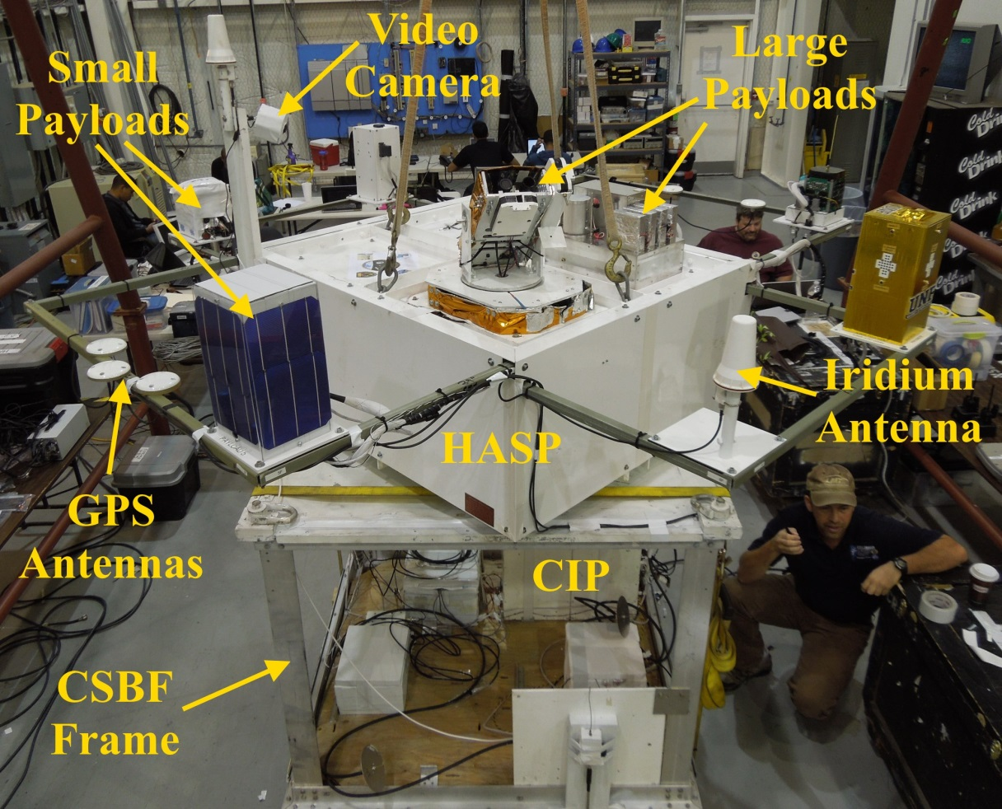
HASP is a Multi-Payload Balloon Platform
Support up to eight payloads < 3 kg and four payloads < 20 kg per flight
HASP supplies payloads with serial downlink & uplink in near real-time, 32 VDC @ < 2.5 A power, discrete commands, analog downlink.
Video cameras provide real-time imaging of payloads and environment

Slide 3
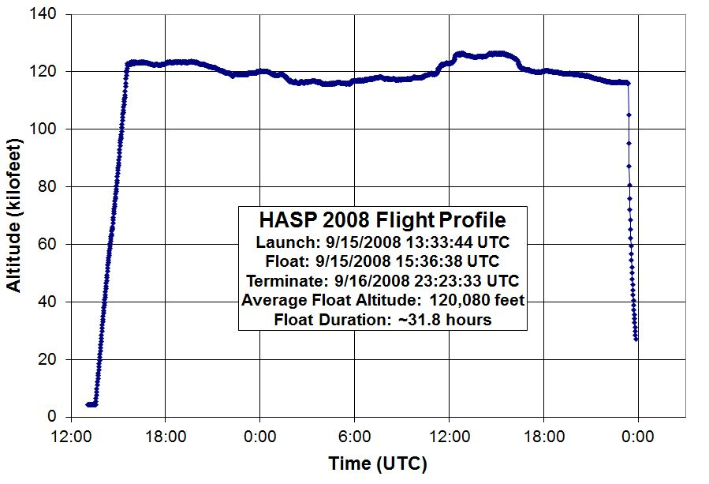
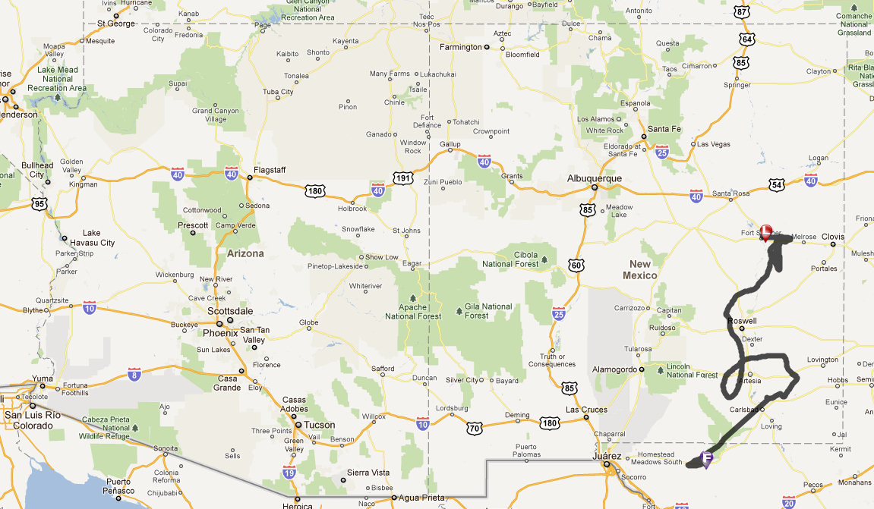
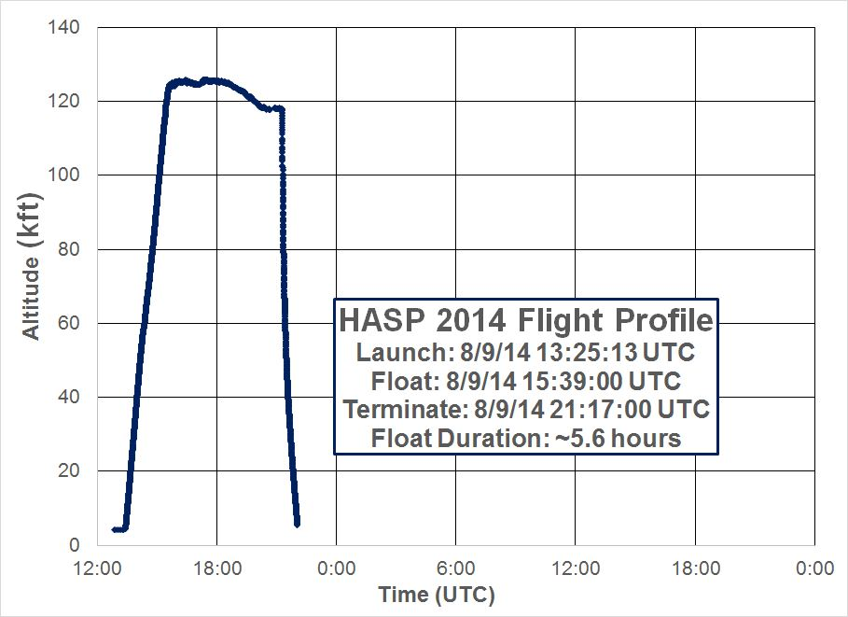
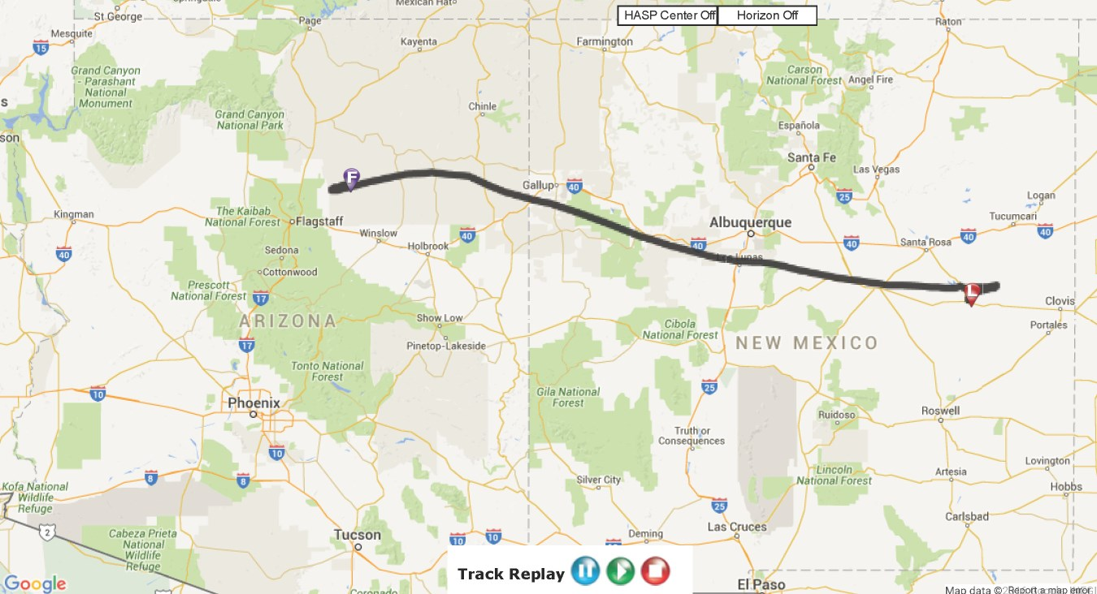
Longest in 2008, Shortest in 2014

Slide 4
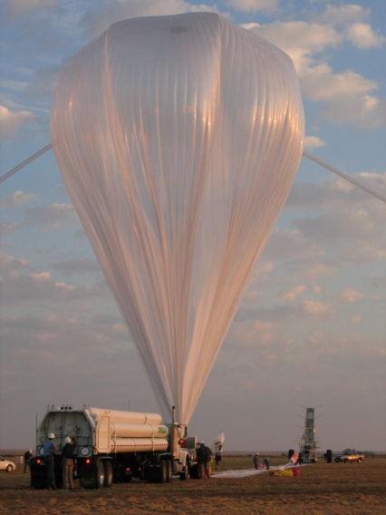
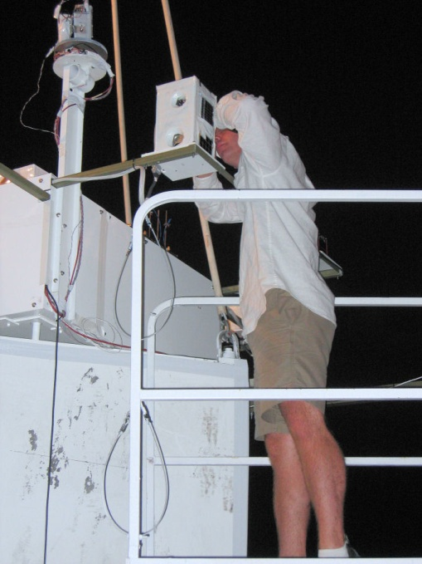
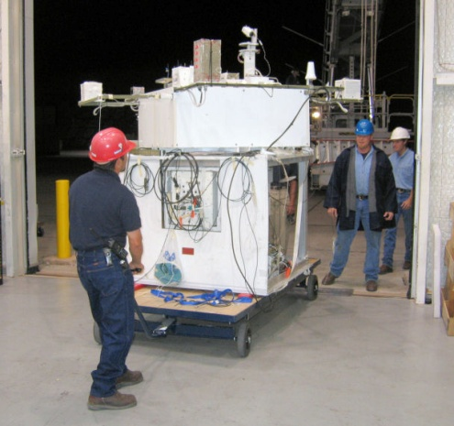
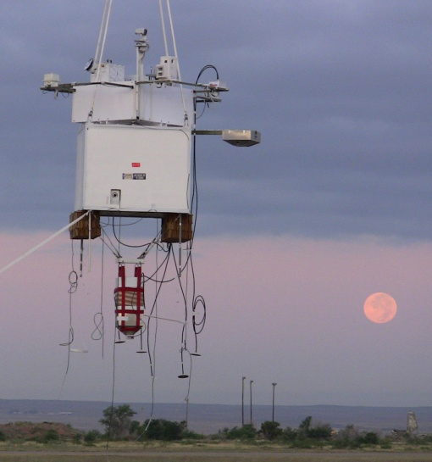
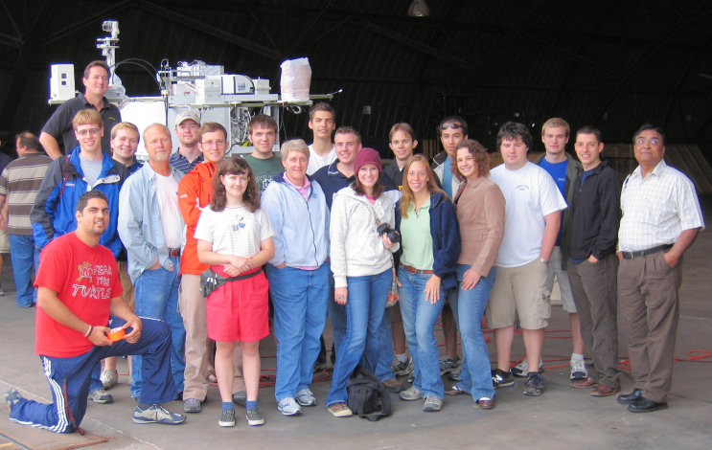
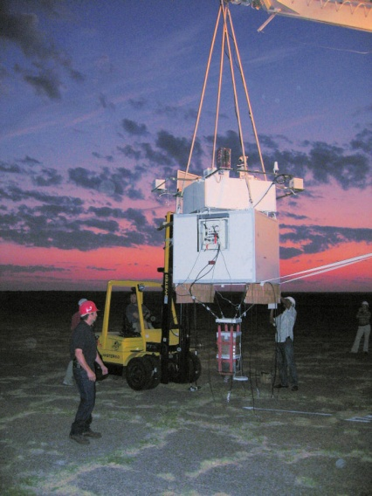
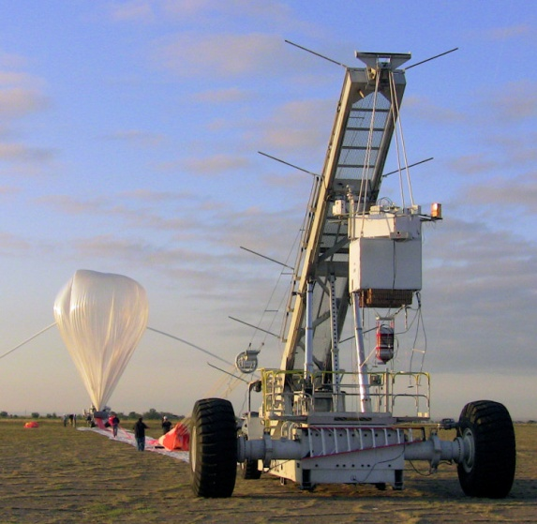
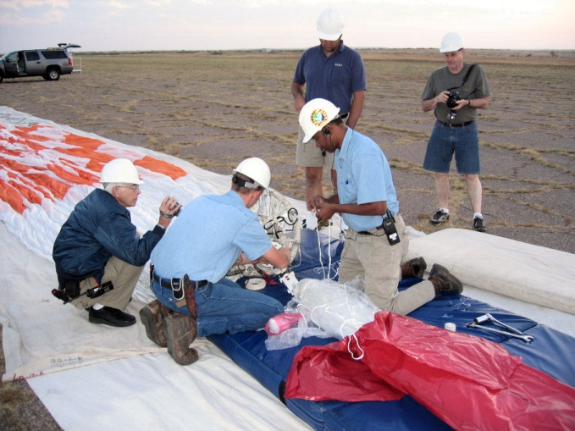
HASP Launch Preparation

Slide 5
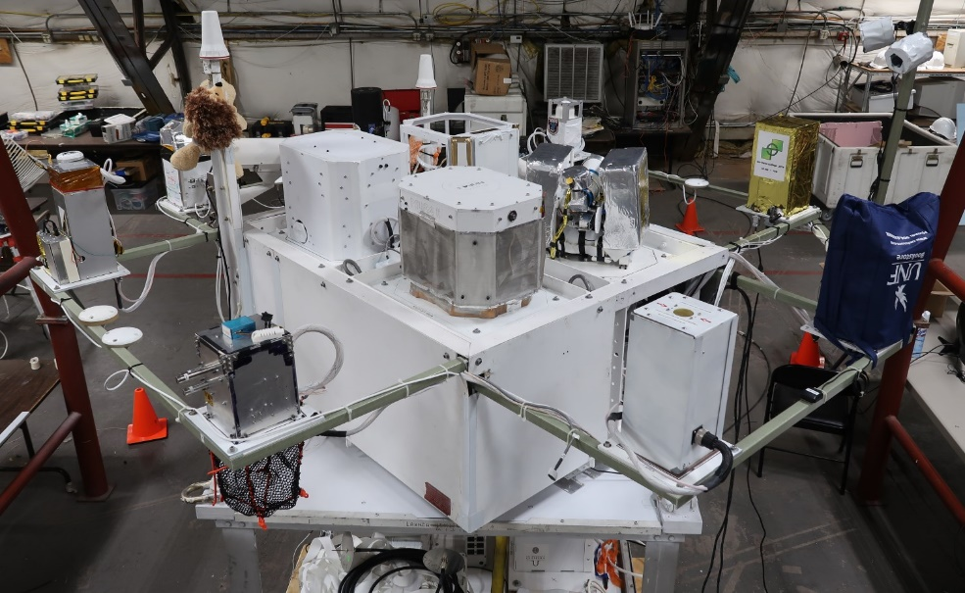
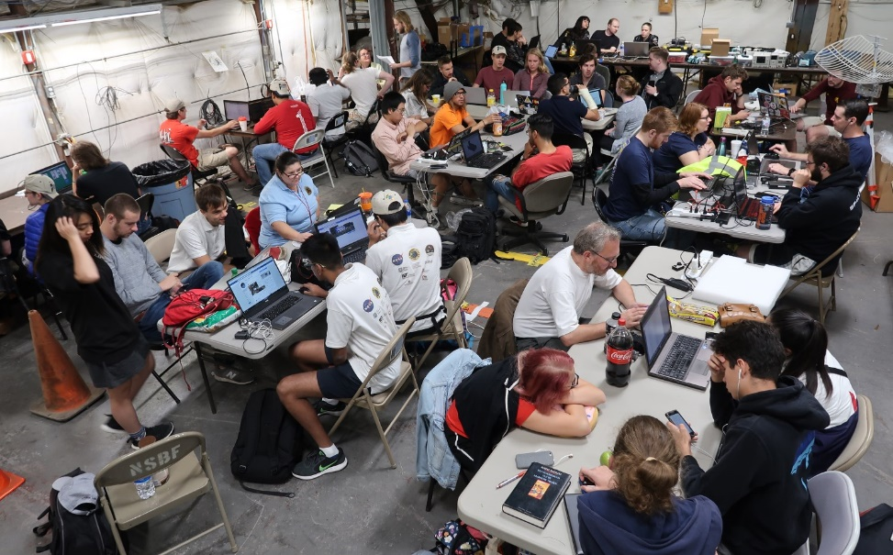
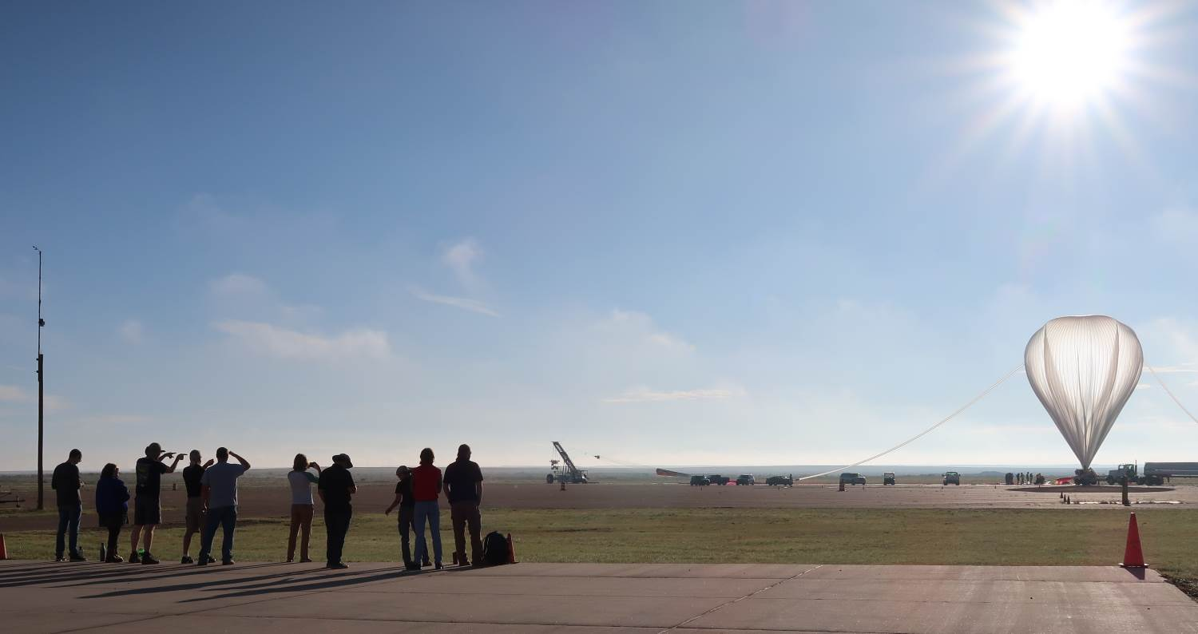
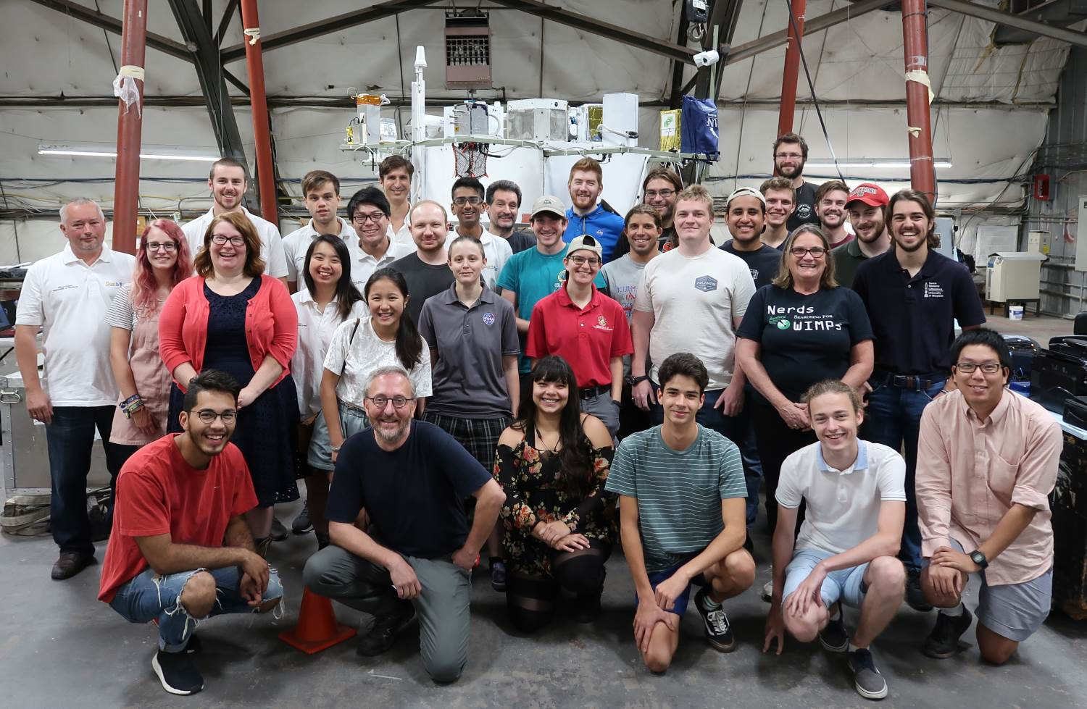
HASP 2018 Payloads and Student Teams

Slide 6
HASP 2021 Schedule
HASP has recently secured funding from the NASA Science Mission Directorate to support flights from 2021 through 2025
The schedule for HASP 2021 is as follows:
Release of HASP 2021 Call for Payloads October 16, 2020
General Q&A Teleconference (via Zoom) November 13, 2020
Application Development Discussion (via Zoom) December 18, 2020
HASP 2021 Payload Applications Due January 8, 2021
Application Selection Announcement End-January 2021
HASP 2021 CFP will be distributed to jurisdiction Space Grant Directors and Coordinators
To be on the distribution, faculty advisors should email to laspace@lsu.edu
Participation in the Nov and Dec conference will require registration. Details will be in the CFP
Further information can be found at the HASP website
https://laspace.lsu.edu/hasp/

