Slide 1

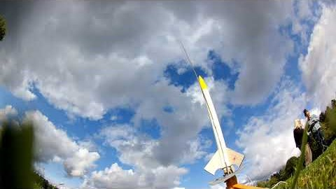
Purchased robotics kits for pre-teachers to use with elementary education students
Developing online series of child & family engagement activities with asynchronous video lessons and
live sessions
Nandagikendan Seek to Learn
Academy rocket launch on
September 9
Ongoing recruiting to Rocketry Club
Upcoming Bell Museum
Statewide Star Party Nov. 9-14
Will do more promotion of
SG activities & grants to students

