Slide 1
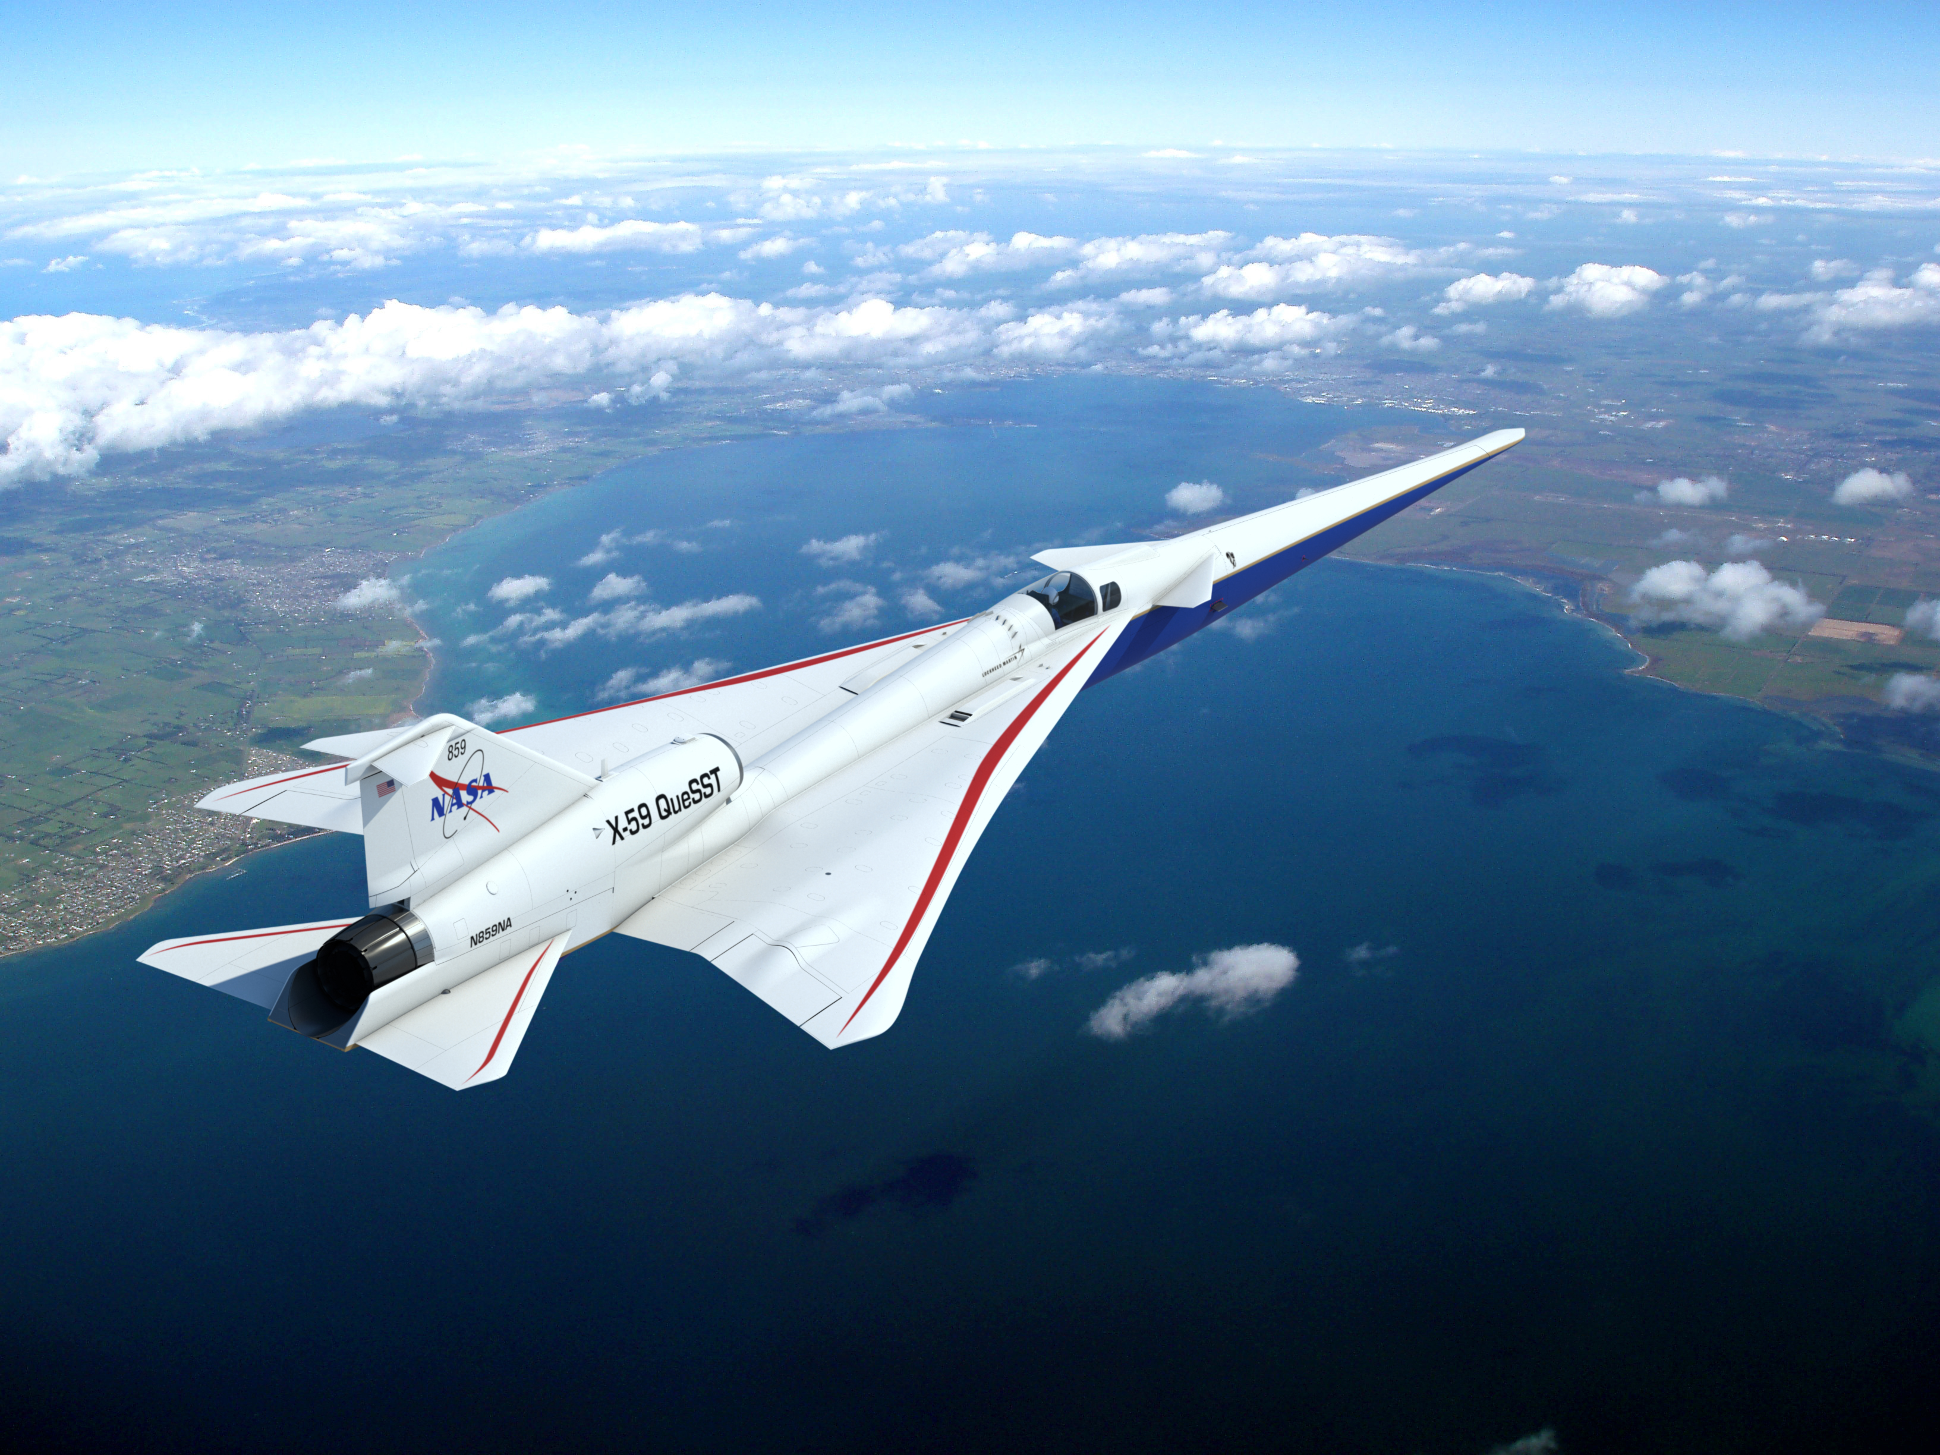

Minnesota Space Grant Consortium
Fall 2020 Affiliates Meeting
October 17, 2020

Slide 2
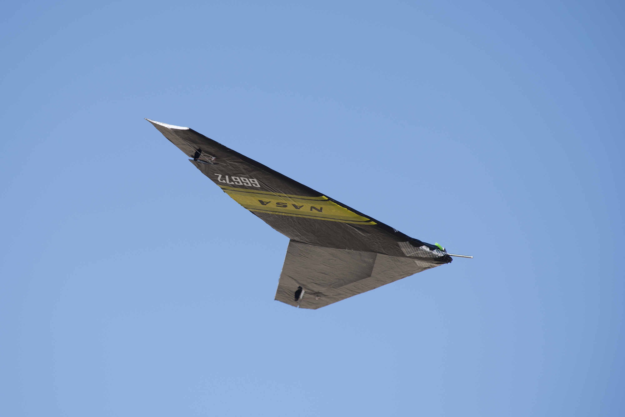
Topics
OSTEM Strategic goals
  Diversity and Inclusion Focus
  Space Grant Strategic Direction
COVID-19 Impacts
Awards and Award Spending
Upcoming Events

Slide 6
