Slide 1
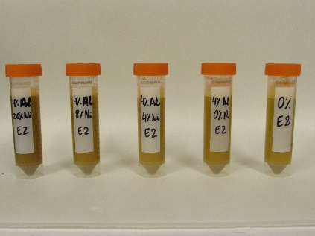
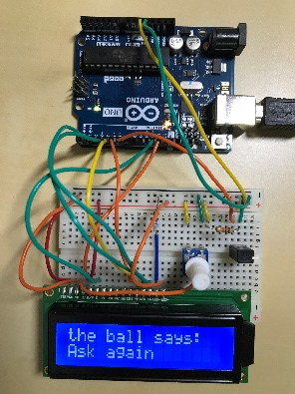
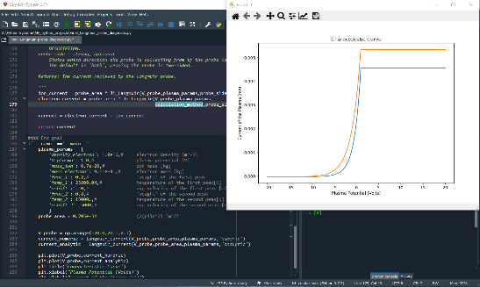
2020 Summer research - online
Thelma Berquó
- Nicholas Lyle: Arduino activities, to be used in Instrumentation lab.
- Bailey Klause: Data analysis of iron oxides. Data obtained in summer and fall 2019.
Luiz Manzoni
- Gabe Holum: They investigated applications of machine learning to physics.
Matthew ArchMiller
- Amy Ott and Noel Geiger: developing computational tools to support experimental plasma physics.
2020-2021 Quadcopter Exploration-Flying Challenge
Organizers: James Flaten, Thelma Berquó and Ben Bogart (TA)
-- 12 teams signed up to be part of the challenge!!!
Kick off was 10/14, technical training is on 10/28.
We will end the activity on 03/31/2021.

