Slide 1
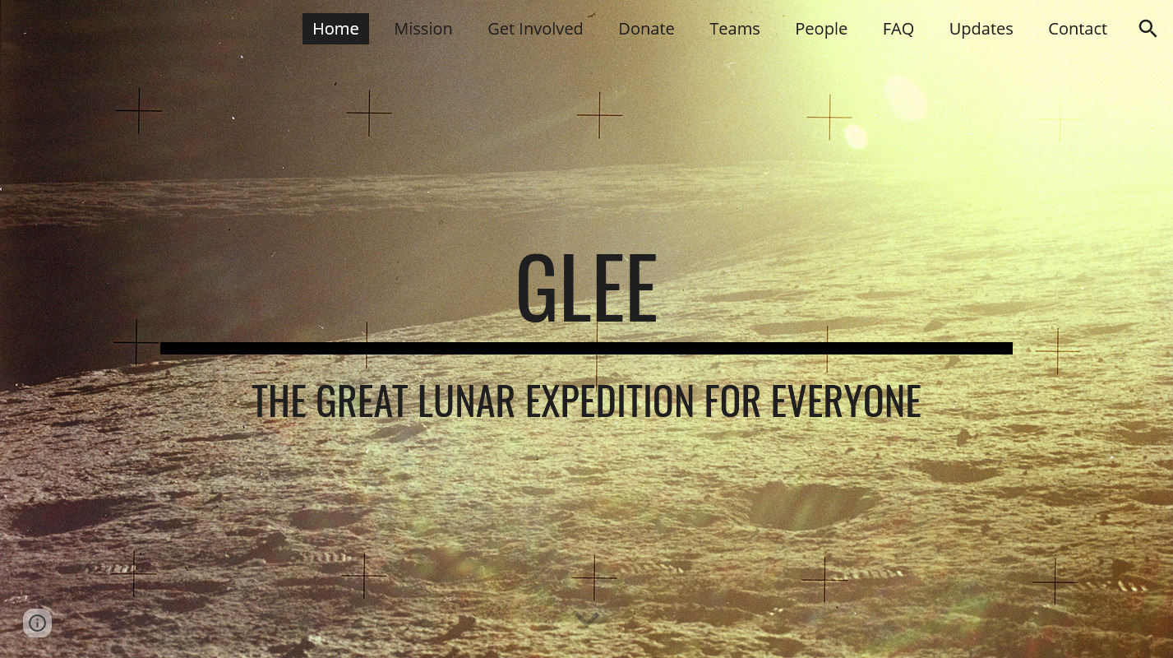
https://www.glee2023.org/

Slide 2
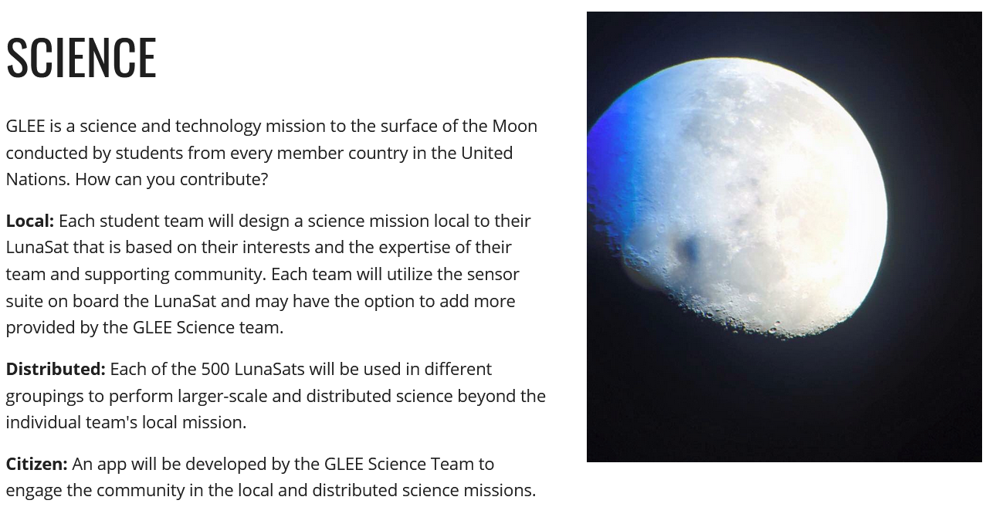
https://www.glee2023.org/

Slide 3
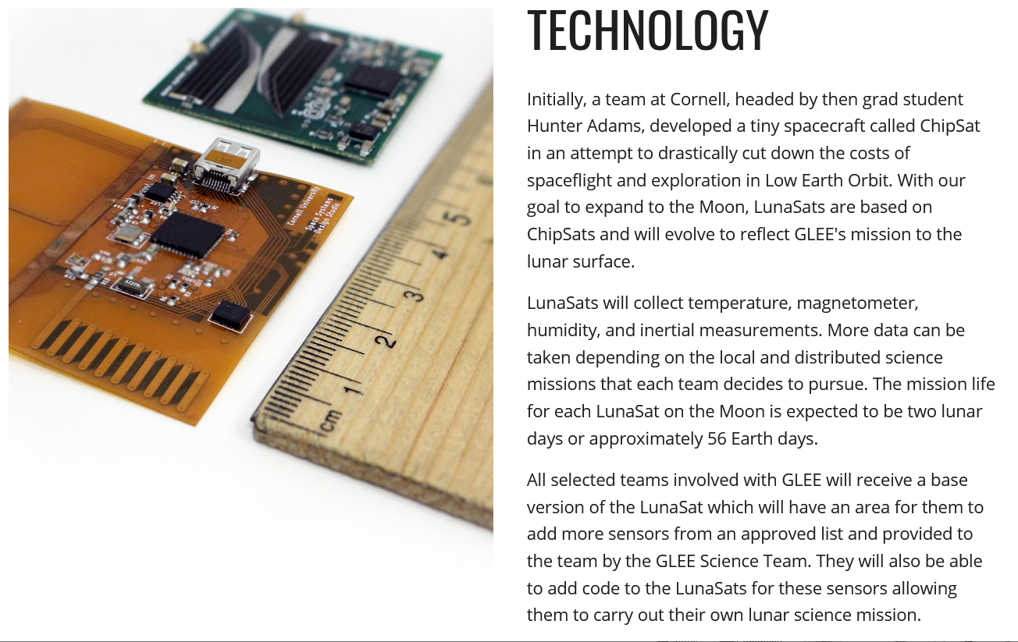
https://www.glee2023.org/

