Slide 1
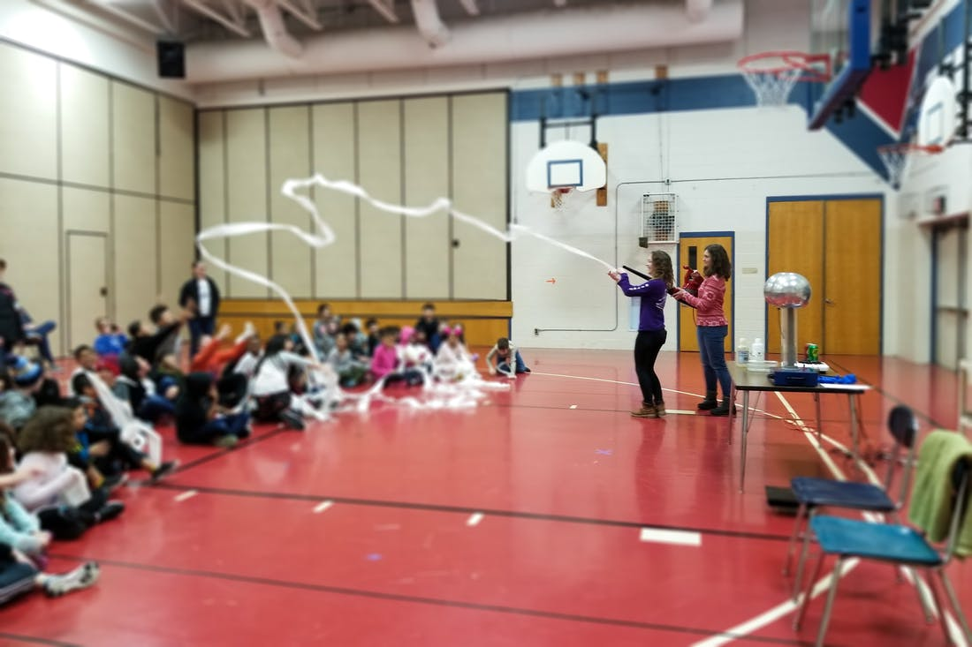
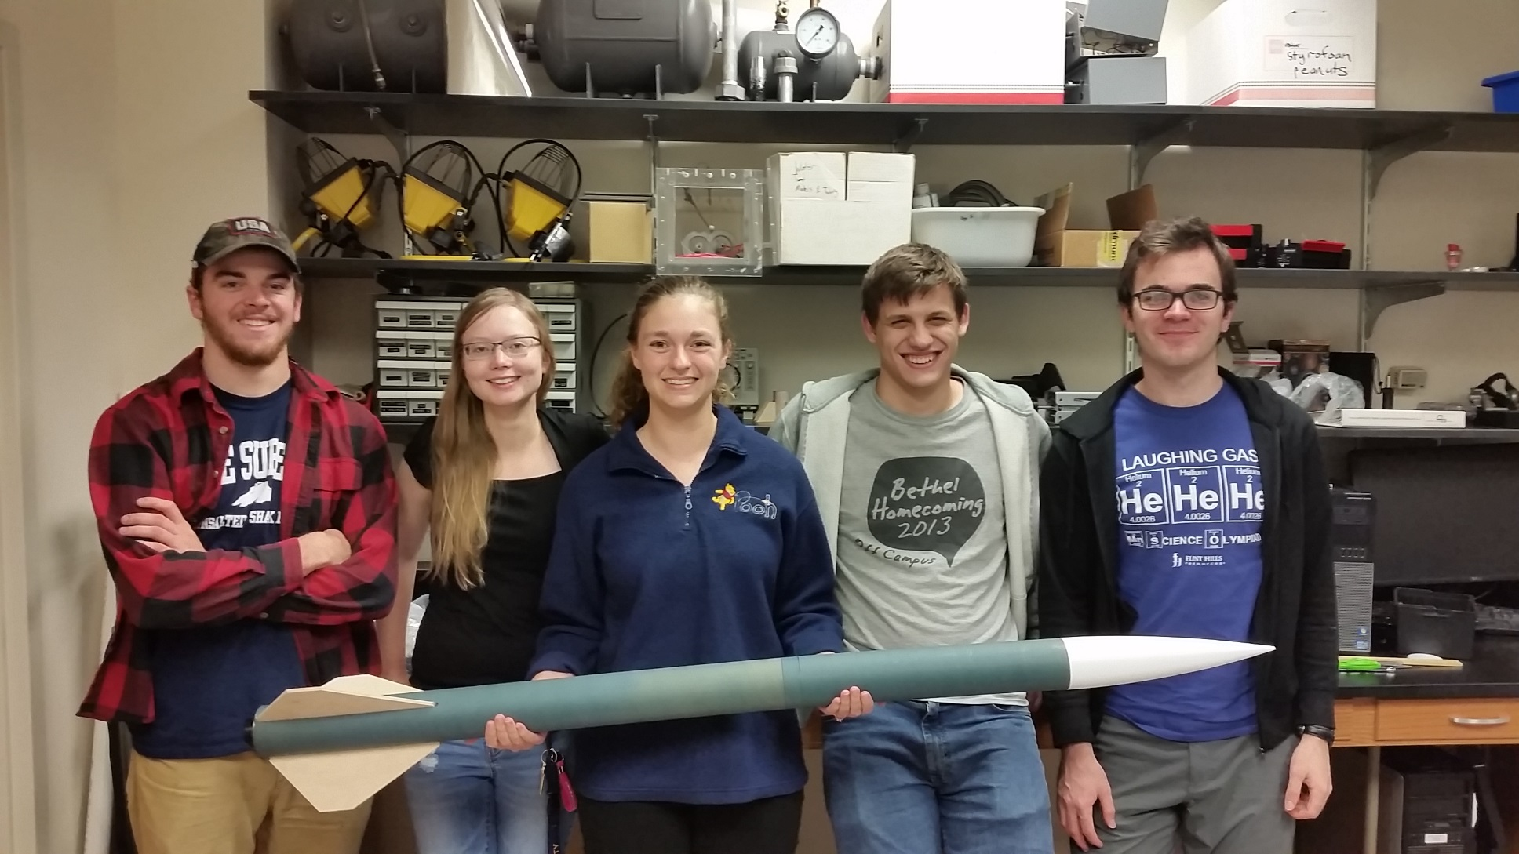
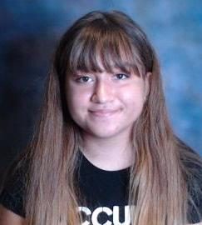
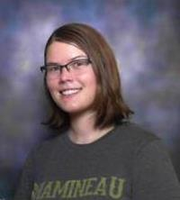
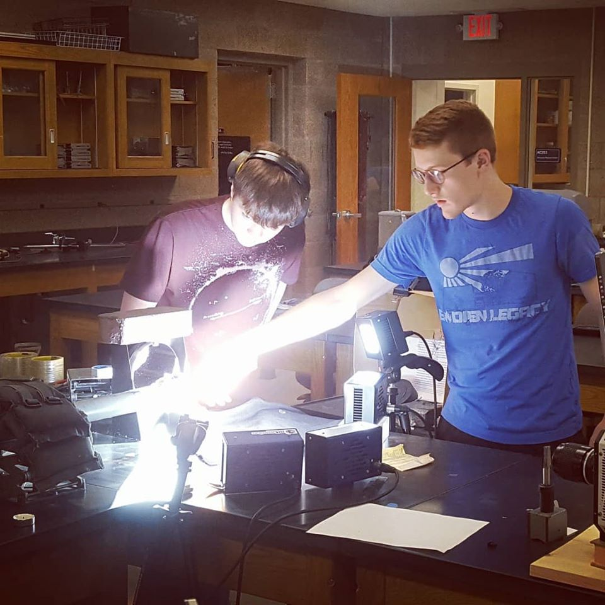
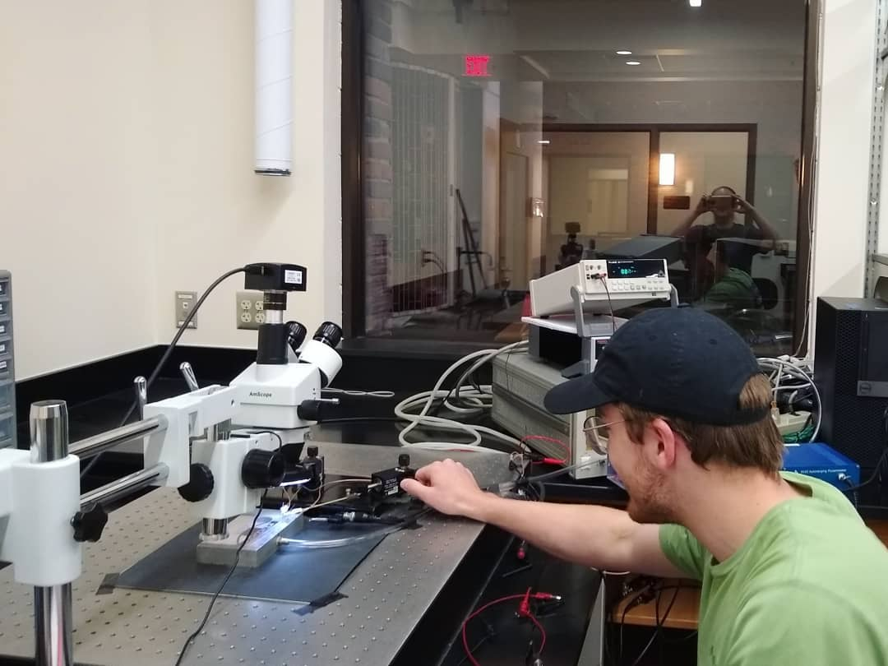
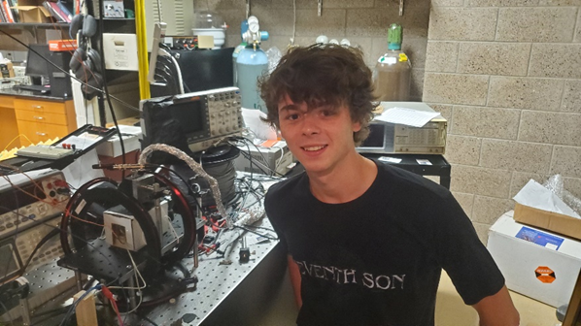
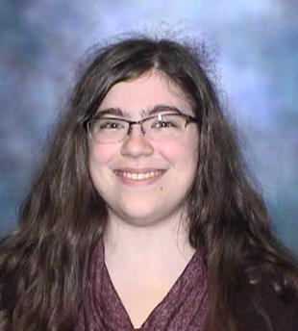
MN Space Grant Consortium Fall 2020 Update – Bethel University
Scholarships
Awarded to high-achieving incoming undergraduate students majoring in Physics or Engineering.
Fall 2020: Chloe Rodriguez, Ellesa St. George
Informal Ed Programming
Outreach through local schools and museums to educate students and the general public on physics and engineering topics.
Most recent: “Rocket Day” for a local homeschool co-op, STEM Event for Civil Air Patrol Cadets (October 2020)
Rocketry Team
Extracurricular group building and launching high-powered rockets.
Higher Ed Course Development
Funding used to develop courses in fields of interest to NASA such as engineering, fluids, and optics.
Summer 2020:
Lab development for Control Systems course
Ordering & assembling kits for Electronics lab (COVID-related)
Made design improvements of supersonic ping-pong cannon (SSPPC) used in student research and the Fluid Mechanics laboratory - provide a more secure mounting of the SSPPC and simplify the process for operation
Design and fabrication of a dual-rotation Taylor-Couette flow apparatus to be used in experiments for the Fluid Mechanics course (Match)
NASA-Related Research
Funding used to explore topics of particular interest to NASA, such as fluids, atomic clocks, and particle physics.
Summer 2020:
Set-up and automation of electrical testing of radiation-hard sensors
2-photon Rubidium transition for atomic clocks in GPS satellites – spectroscopy, line width, and assembly for laser locking
Conferences:
E. Jagt and J. Hogan, “Search for vector-like quarks with a columnar analysis framework”, APS April Meeting, held virtually, April 2020.
R. Beard and N. Lemke, "Two-photon spectroscopy with Rubidium at 778 nm," Symposium on Undergraduate Research, Division of Laser Science APS, LS XXXVI, held virtually, September (2020).
Contact: Alyssa Hamre Kontak, Assistant Professor of Physics, akh46956@bethel.edu

