Slide 1
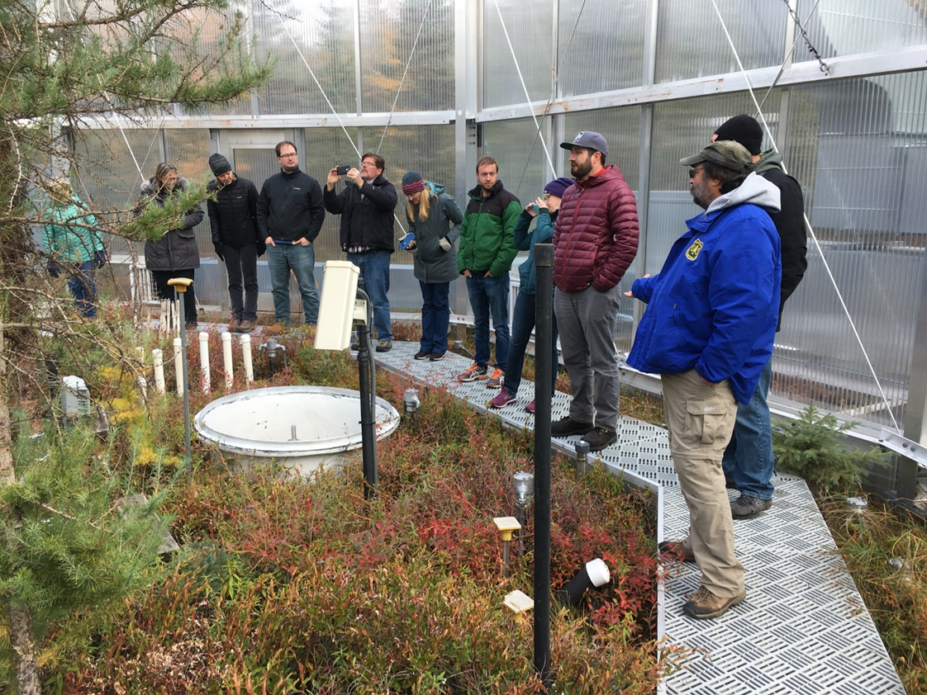
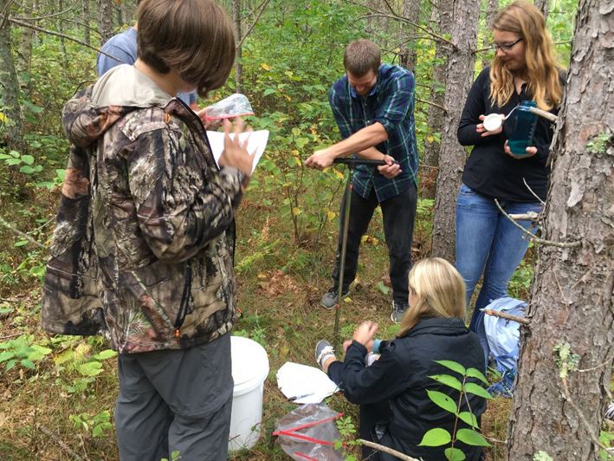
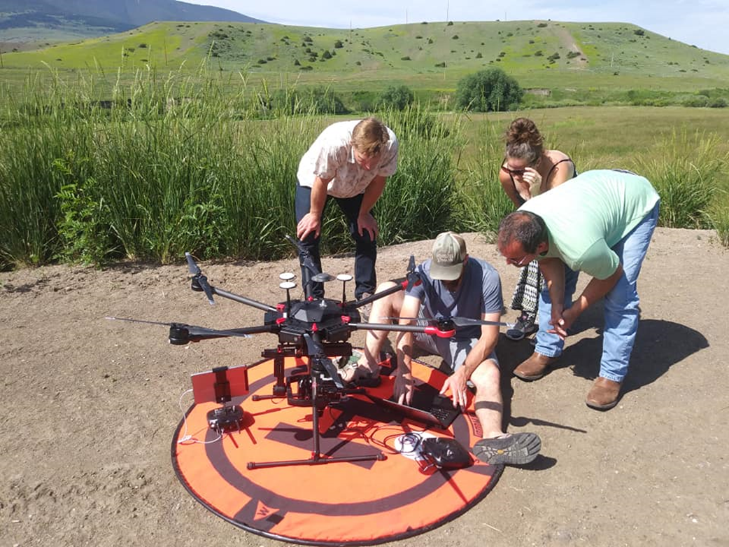
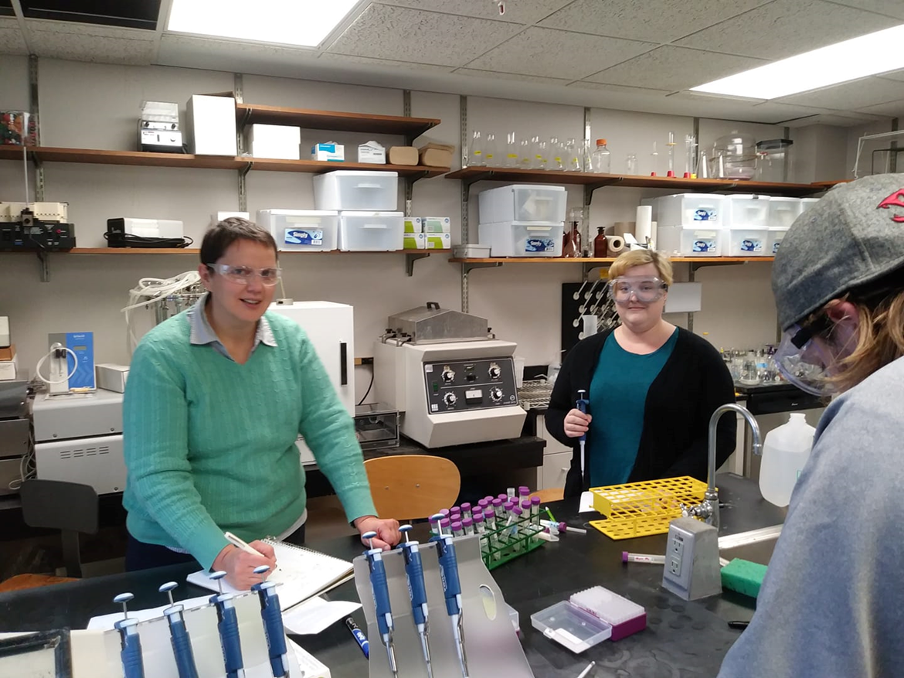
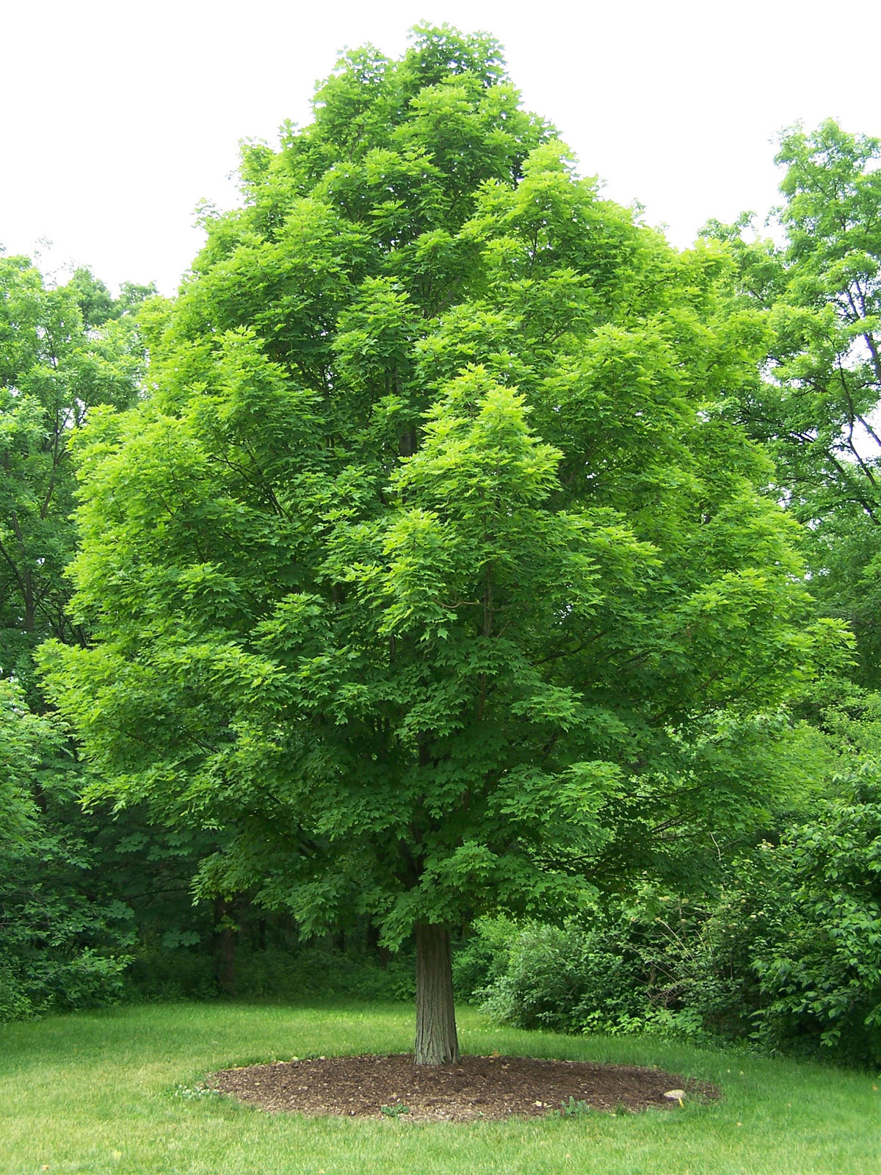
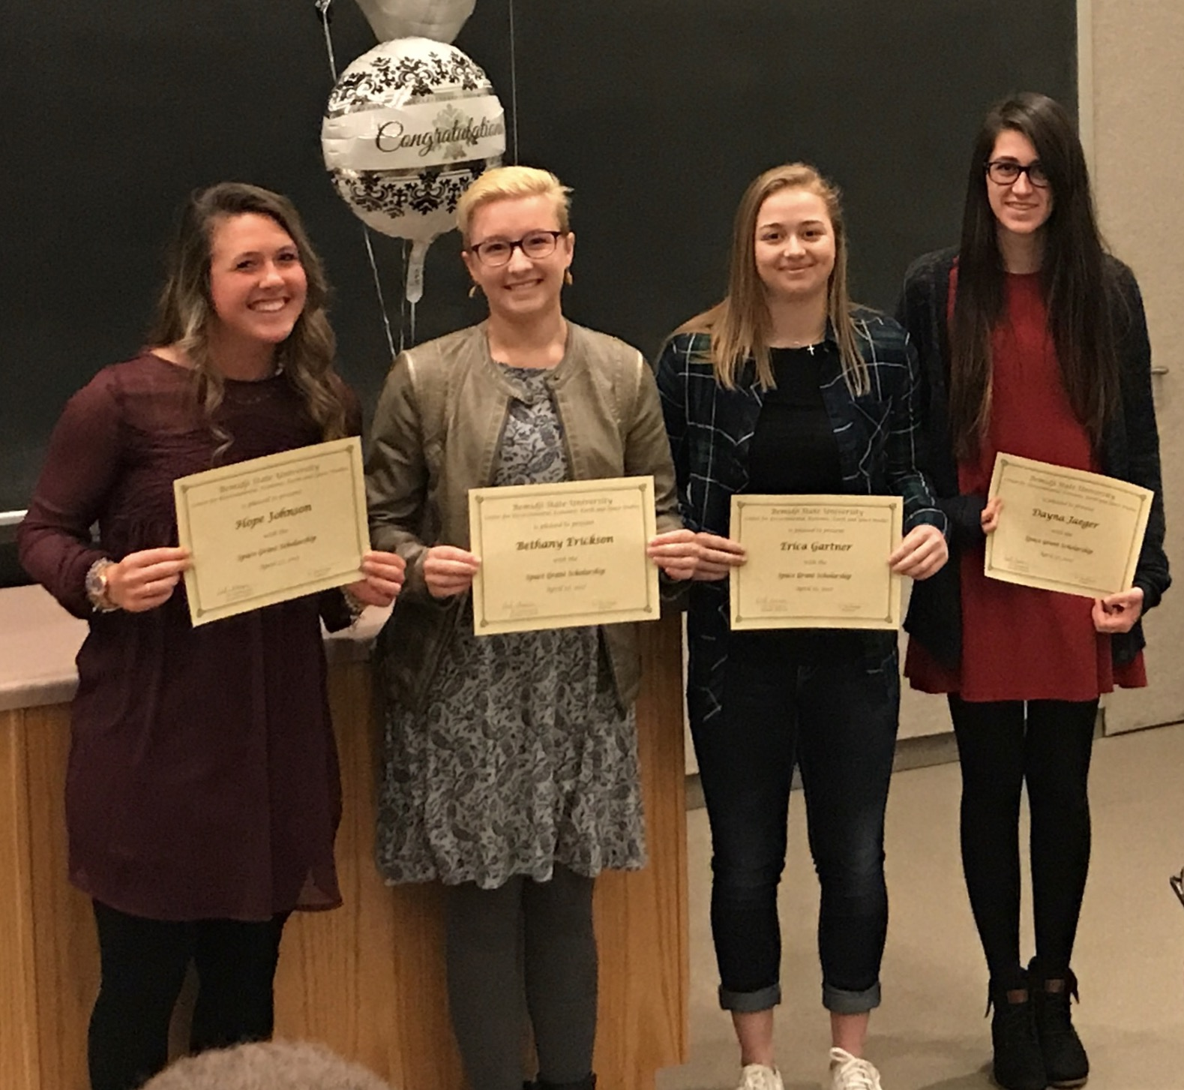
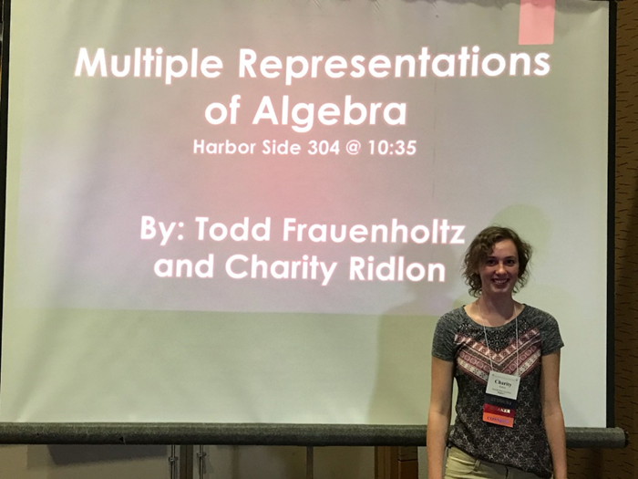
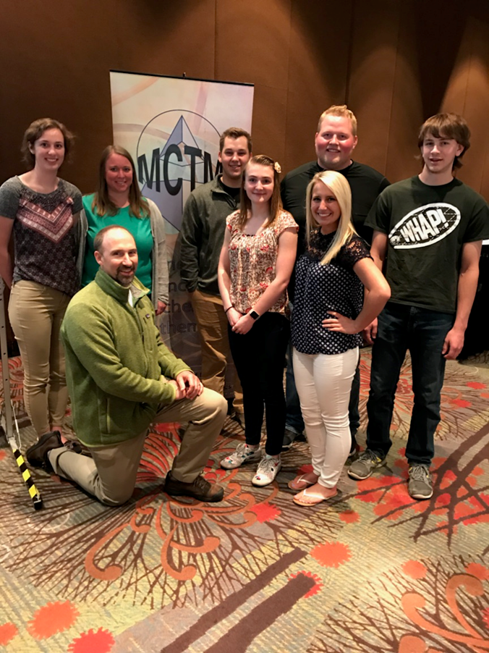
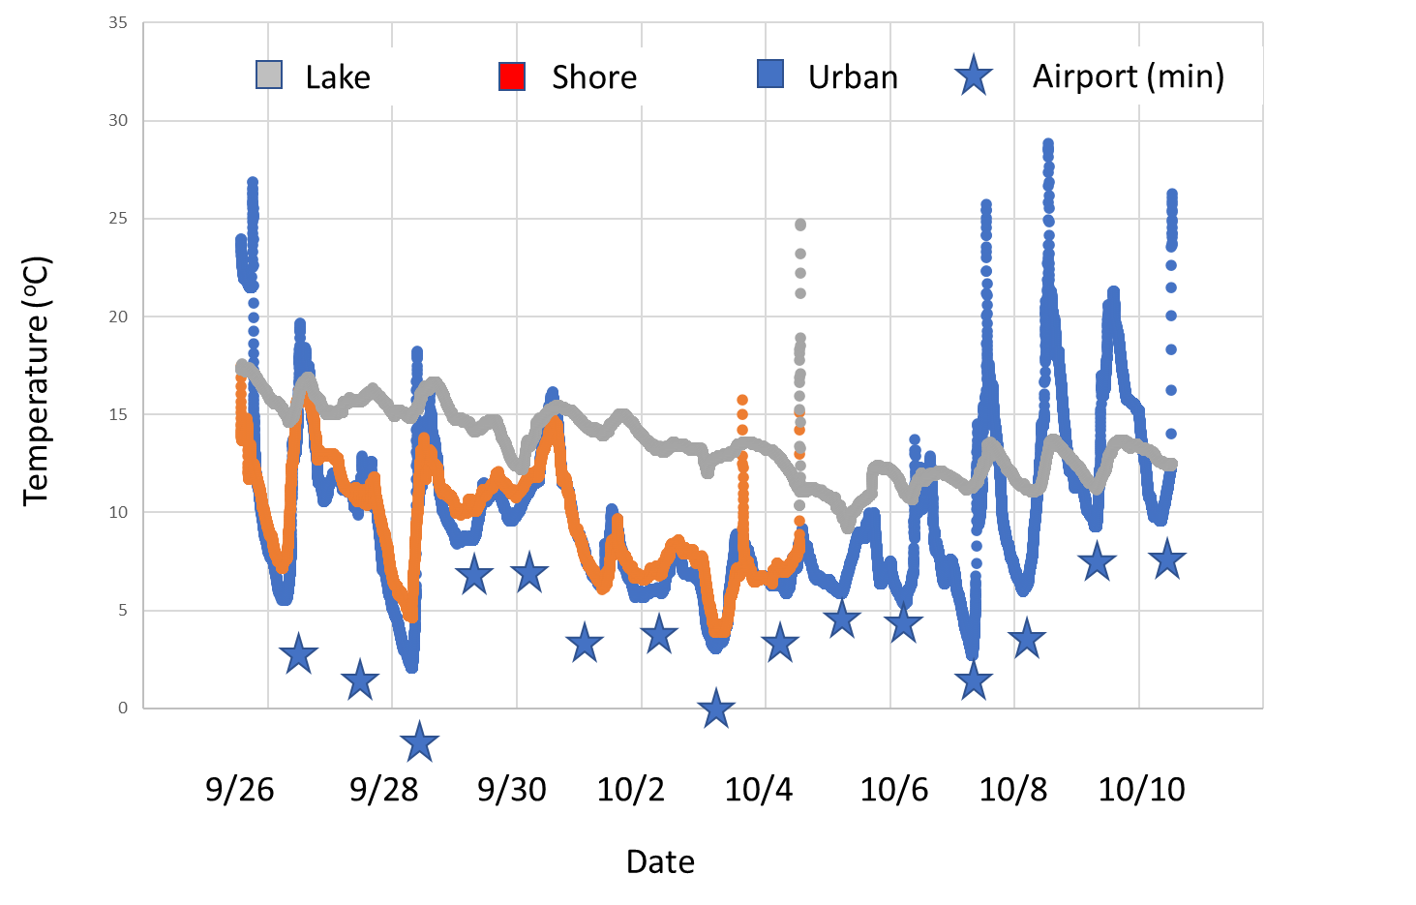
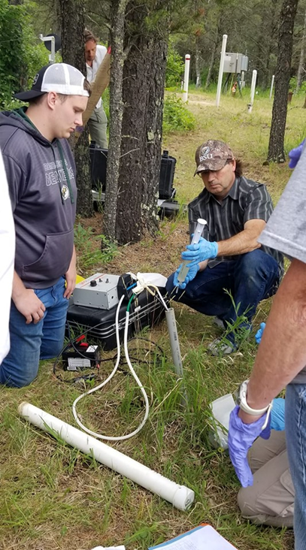
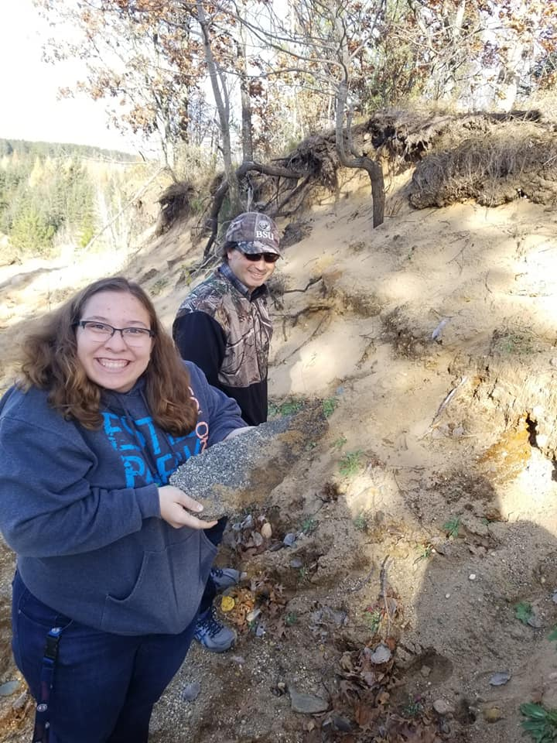
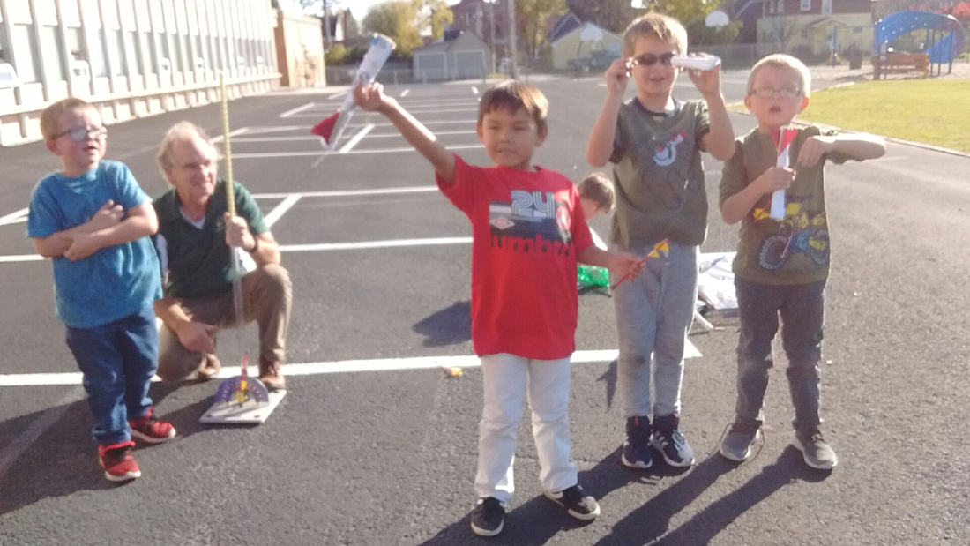
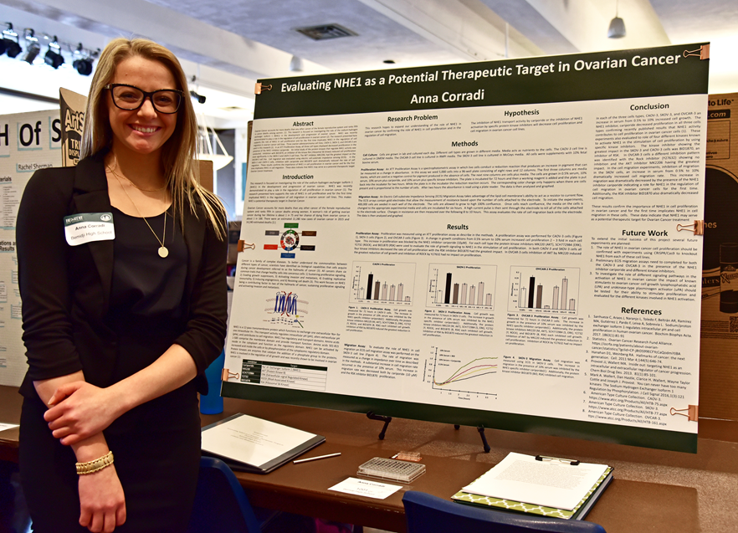
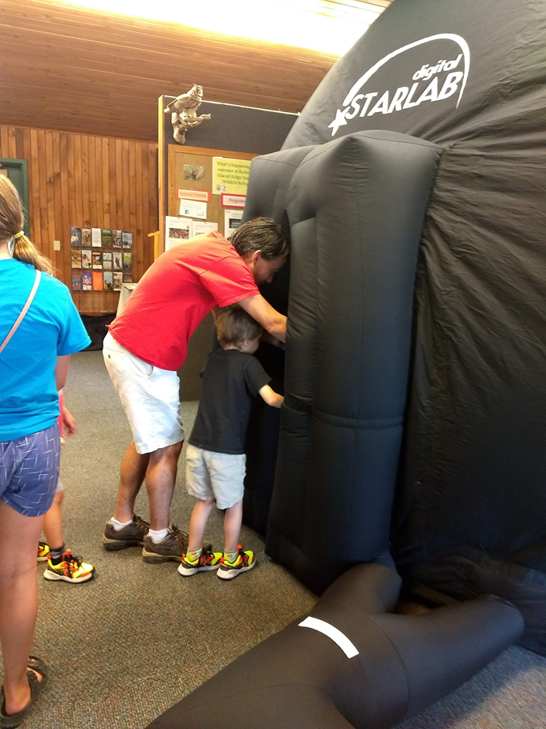
NASA’s MN Space Grant Consortium (MnSGC) Activities at Bemidji State University
Academic Affiliates of The mnsgc
U of mn – twin cities (lead institution)
Augsburg UNIVERSITY, minneapolis
Bemidji State University, Bemidji
Bethel University, St. paul
Carleton College, northfield
Concordia College, moorhead
Fond du lac Tribal and Comm. Coll., cloquet
Leech lake tribal college, cass lake
Macalester college, st. paul
St. catherine university, st. paul
U of MN – Duluth
University of St. thomas, st. paul
Non-higher-Ed Affiliates & partners
Mndot – office of aeronautics, st. paul
Science museum of mN, st. paul
Bell museum of natural history, st. paul
Headwaters science center, Bemidji
TRIPOLI MN (HIGH POWER ROCKETRY CLUB)
Mn science teachers association (mnsta)
MN earth science teachers association (mesta)
scimathmn
Mn astronomical society
Minnesota 4-h
Minneapolis & St paul public school districts
Other schools and school districts
Climate Change Field Work
support BSU college students to participate in field work and tours of national recognized field site in Northern Minnesota. Student make field measurements of ecosystem response to global change.
Fellowships/Scholarships
Support full-time college students at MnSGC institutions majoring in NASA-related STEM fields with undergraduate scholarships.
NASA-Related Research
Support both faculty and students at
MnSGC institutions by helping fund
STEM research projects in areas of
interest to NASA Research Centers.
Higher Ed Course Development
Support new-course development and the
revision of existing courses on topics of
particular interest to NASA, water quality, natural resource management, and climate change.
Pre-College Teacher Support
Supporting Mathematics Education student’s attendance at Minnesota Council of Teachers of Mathematics conference.
Matching Requirement
All recipients of MnSGC programmatic
(i.e. non-Fellowship/Scholarship) funds
are required to provide at least a 1-to-1
match of new-money or in-kind value.
Learn More / Contact Us
Bemidji State University MnSGC Affiliate Director:
Prof. Carl Isaacson:
Carl.Isaacson@bemidjistate.edu
General MnSGC e-mail: mnsgc@umn.edu
General MnSGC website: http://www.mnspacegrant.org
Geology Field Work
support BSU college students to participate in field work relevant to Northern Minnesota. Student make geophysical measurements at an oi spill site and tour outcrops of geological interest in the arrowhead.
Informal Ed Programming
Offer presentations on topics of interest to NASA for specific groups (like school groups, regional science fairs, and the general public) to educate people about NASA and aerospace opportunities.

