Slide 1
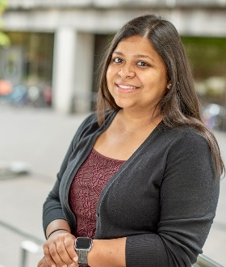
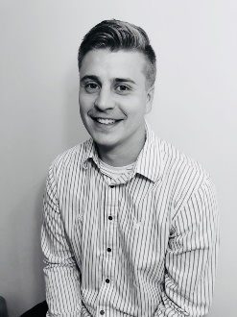
Fall 2020 NASA Space Grant @Augsburg
Alumni Gatherings
Research Infrastructure:
Research Support & Successes:
Computation in the Physics Curriculum:
Students Supported Summer 2020:
Kyra Billman Jade Boysen
Kei Heltemes Edwin Panora
Kong Yang

