Slide 1
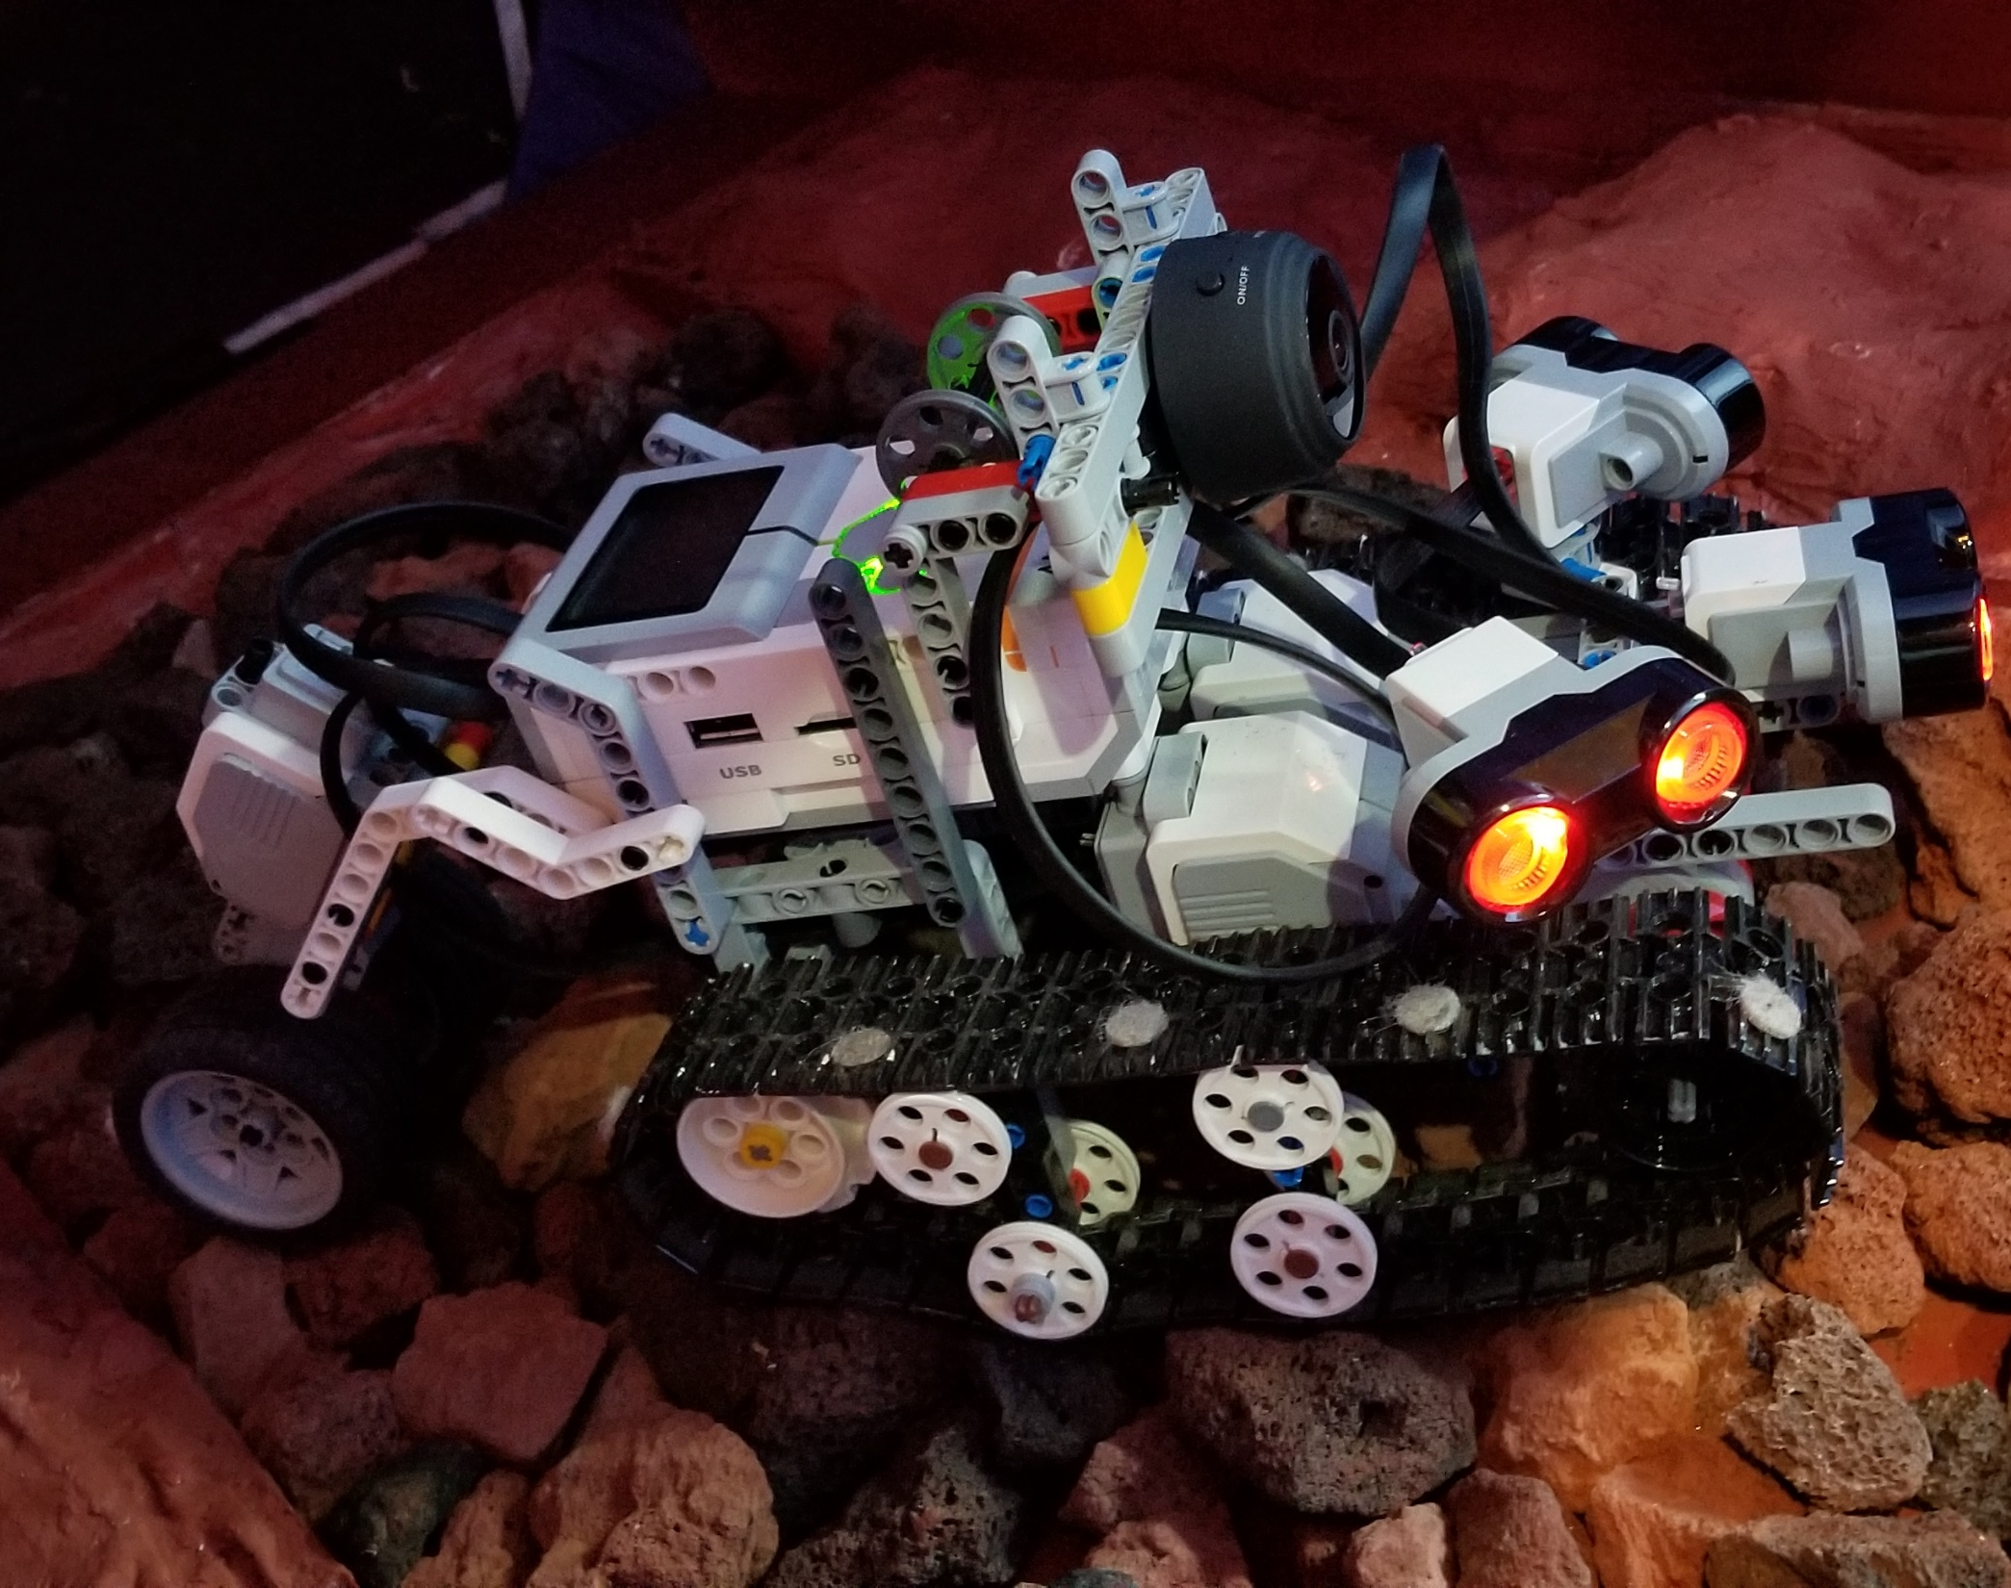
Artemis Lunar Technology Exploration Challenge
Robert Winglee, Mary Denmon
Washington Space Grant
Goal: To have diverse group of students participate and gain experience in developing technologies relevant for exploring dangerous areas on the Moon that could provide important resources for a permanent presence on the Moon

Slide 2
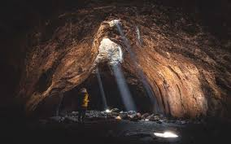
Lunar Lava Tubes
require little construction and enable a habitat to be placed inside with a minimal amount of building or burrowing;
provide protection from natural hazards (i.e., cosmic rays, meteorites and micrometeorite impacts, impact crater ejecta)
access to pristine lunar material
the lava tubes can also provide ready access to volatile chemical elements, such as sulfur, iron and oxygen rich material

Slide 3
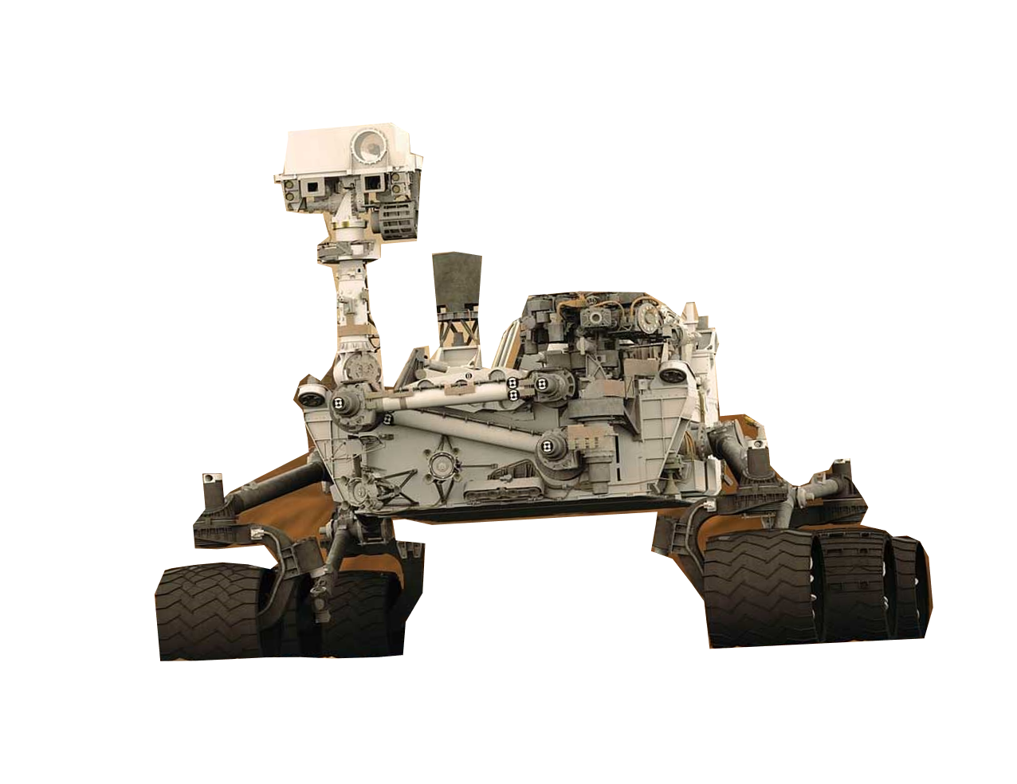
Challenge: Navigate the Tunnel System in the Dark
Entrance by a skylight
Rocky/Sandy Debris
Unknown pathways
Squeeze ways
Floor drops and steps
Attempt to Block off a Tunnel for future habitat
Image a rock sample
Imagine Your Robot Here

Slide 4
High Functioning Robot:
Sensor Array
WiFi Camera
Winch System
Rocker Boggie
Tank Tracks

Slide 5
Video removed – too large to post in archive – contact James Flaten if you’d really like to see it.

Slide 6
Team Logistics
Support for about 30 teams
$2,000-$3,000 support available for supplies/robots for qualifying teams
Team training sessions based on materials developed from students in Phase I
Opportunities to debug and refine system
Development Challenge events that will serve as progress checkpoints
Steep hill climb
Step up challenge

Slide 7
Facilitating a Team Challenge During COVID-19
Team members working away from the challenge course will be part of the Earth Base
At least one robot with team members collaborating virtually for programming and robot modifications
Additional robot located to location where challenge course is set up (e.g. WA, WV, TX, MT) – Lunar Base
Earth Base students provide code and build modifications to a funded “astronaut” at the Lunar Base who will run the robot for the team and provide data on performance
Regional Challenge Day: robots run the course in a fixed time period with communication allowed between Earth Base and Lunar Base

Slide 8
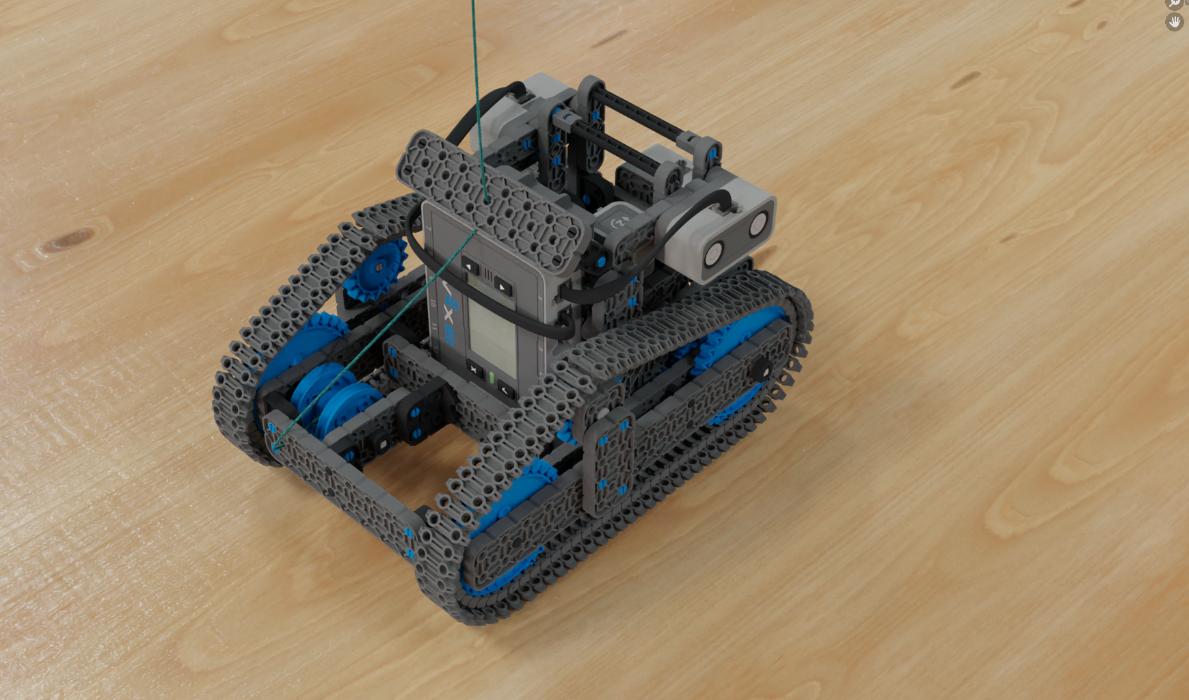
Challenge Divisions
Different points of entry based on knowledge and prior experience
Orion: VEX IQ or LEGO EV3, rapid prototyping, not required to be autonomous
Gateway: VEX V5 or custom rover, some autonomous elements
Shackleton: Custom rover, autonomous navigation
Notes:
Orion – ideal for students with no or limited prior programming and design experience
Gateway -- for students with some prior knowledge or experience, some elements can be manual (such as deploying tunnel closure or barrier)
Shackleton – for students with solid programming and design experience, most refined solutions

Slide 9
Challenge Divisions
Different points of entry based on knowledge and prior experience
Orion: VEX IQ or LEGO EV3, rapid prototyping, not required to be autonomous
Gateway: VEX V5 or custom rover, some autonomous elements
Shackleton: Custom rover, autonomous navigation
Encourage your student URM science and engineering organizations to apply
As well as your community colleges, MSI’s and non-research schools
WSGC will provide training for all teams in the Orion Division
Notes:
Orion – ideal for students with no or limited prior programming and design experience
Gateway -- for students with some prior knowledge or experience, some elements can be manual (such as deploying tunnel closure or barrier)
Shackleton – for students with solid programming and design experience, most refined solutions

Slide 10
Time Table:
November 16, 2020 | Registration Opens
Nov. – Dec. 2020 | Development event with Amazon AI Group
January, 2021 | Recruitment support meeting
January 19, 2021 | Registration Closes
Jan – March, 2021 | Science Matter Expert Talks
Jan – March, 2021 | Team trainings
Late March, 2021 | Development Challenge
Mid-April, 2021 | Regional Challenge
June – July 2021 | Grand Challenge (dependent on Covid19 conditions)

Slide 12
Questions:

